Slide 1

Undulator Working Group
Summary
Heinz-Dieter Nuhn – Alexander Temnykh
Presented at
Friday, March 9, 2012

Slide 2
Schedule of Presentations Covered
Monday
  Benson, “Introduction, Working Group Charge”
  Clarke, “Status of the UK Superconducting Undulator Studies”
  Bisognano, “Short Period Undulators for FELS Workshop”
  Nuhn, “Delta R&D Project at SLAC”
Tuesday (Joint Session with Compact Sources)
Wednesday
  Nuhn, “Radiation Monitoring at the LCLS Undulator System”
  Temnykh, “Permanent Magnet Demagnetization Induced by High Energy Electron Radiation”
Thursday (Joint Session with Storage Rings)
  Casalbuoni, “Superconducting Insertion Devices”
  Temnykh, “CHESS Compact Undulator”
  Couprie, “Insertion Device Activities at SOLEIL”
  Chubar, “Parametric of In-Vacuum Undulators and Segmented Adaptive-Gap Undulator”

Slide 3
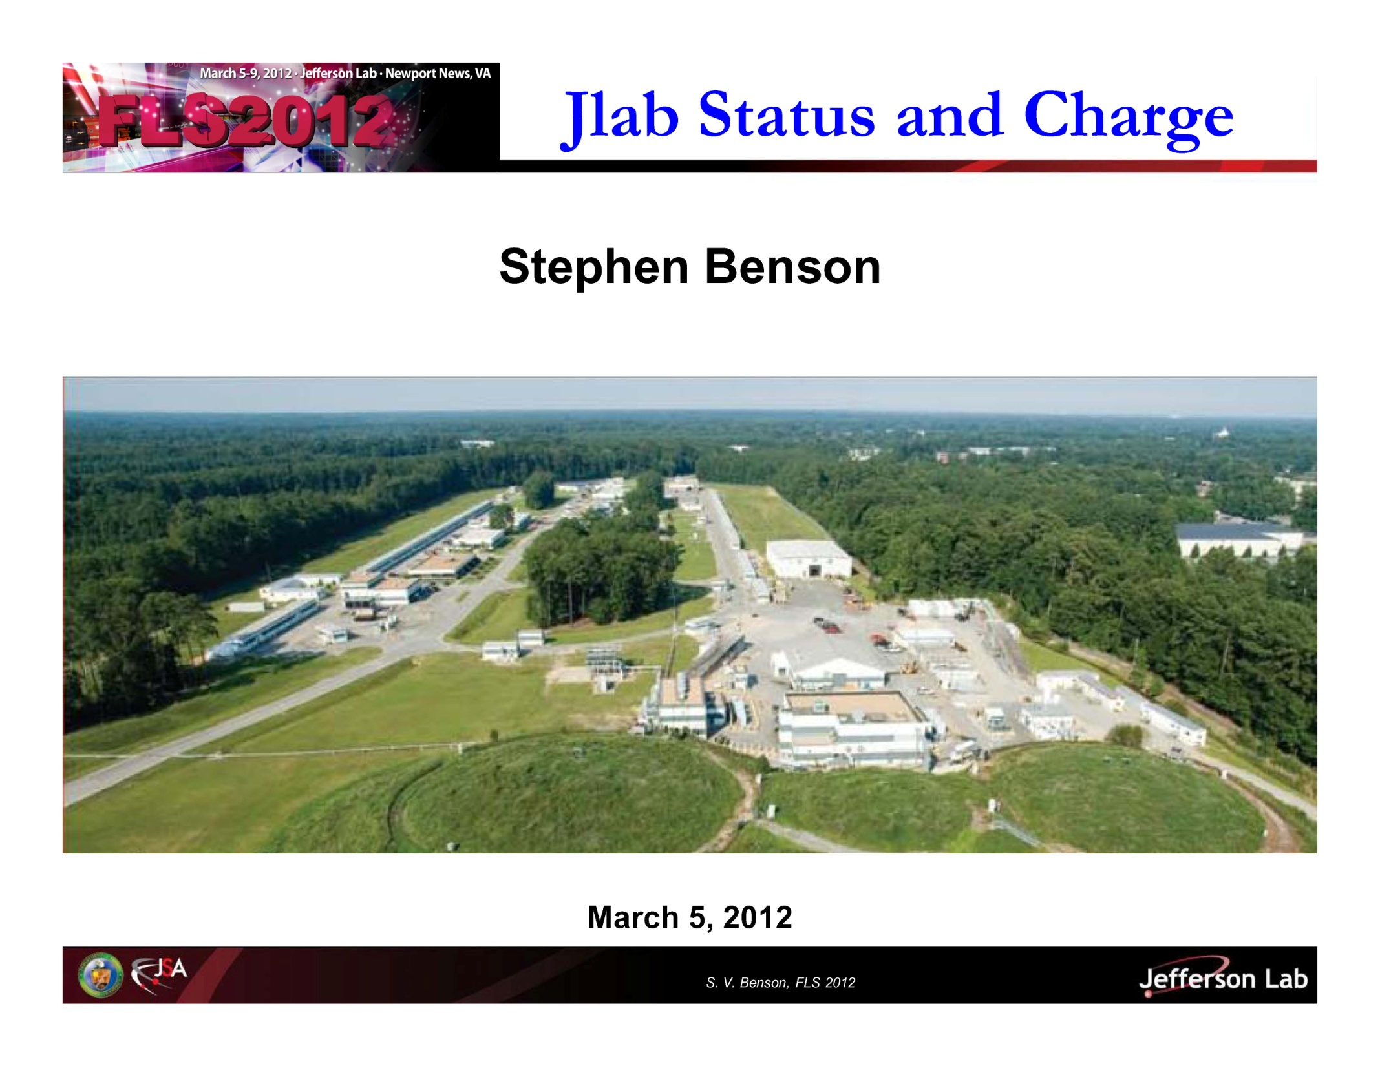

Slide 4
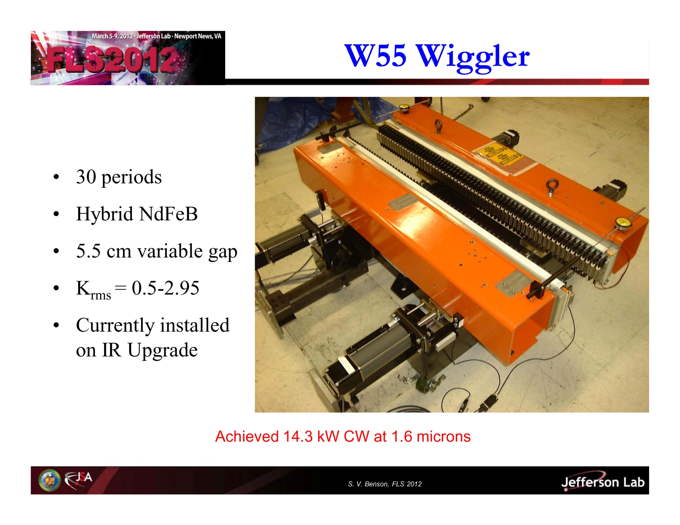

Slide 5
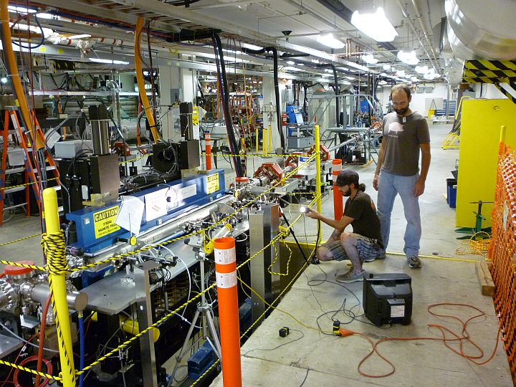
W33 Cornell Wiggler
60 periods
Hybrid NdFeB
3.3 cm variable gap
K_{rms} = 0.5-1.51
Jaws returned to Cornell
Achieved 200 Watts CW at 400 nm, mirror limited

Slide 6
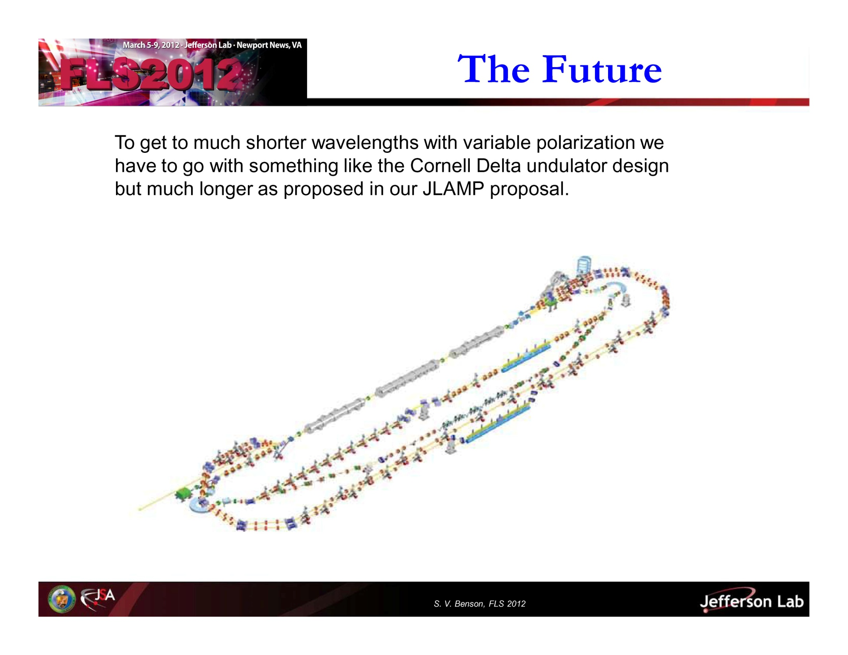

Slide 7
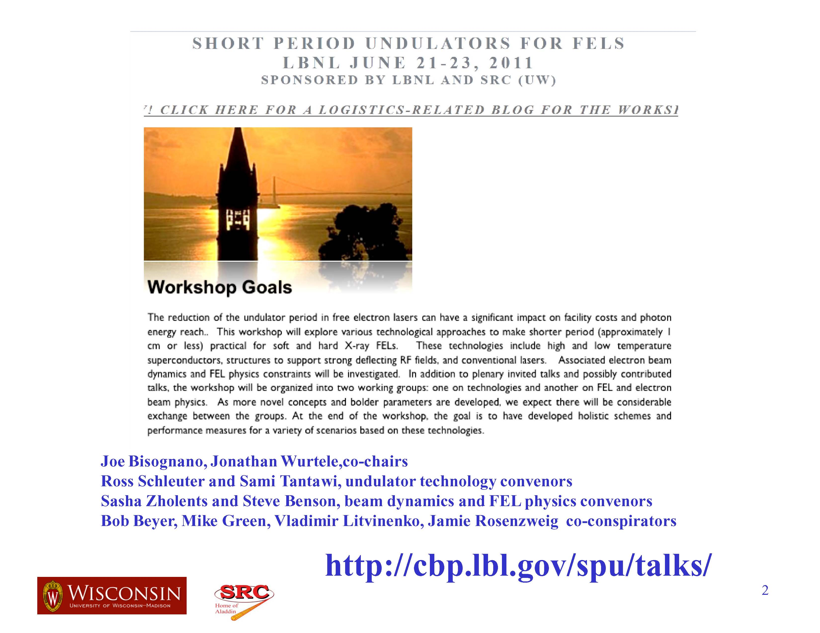

Slide 8
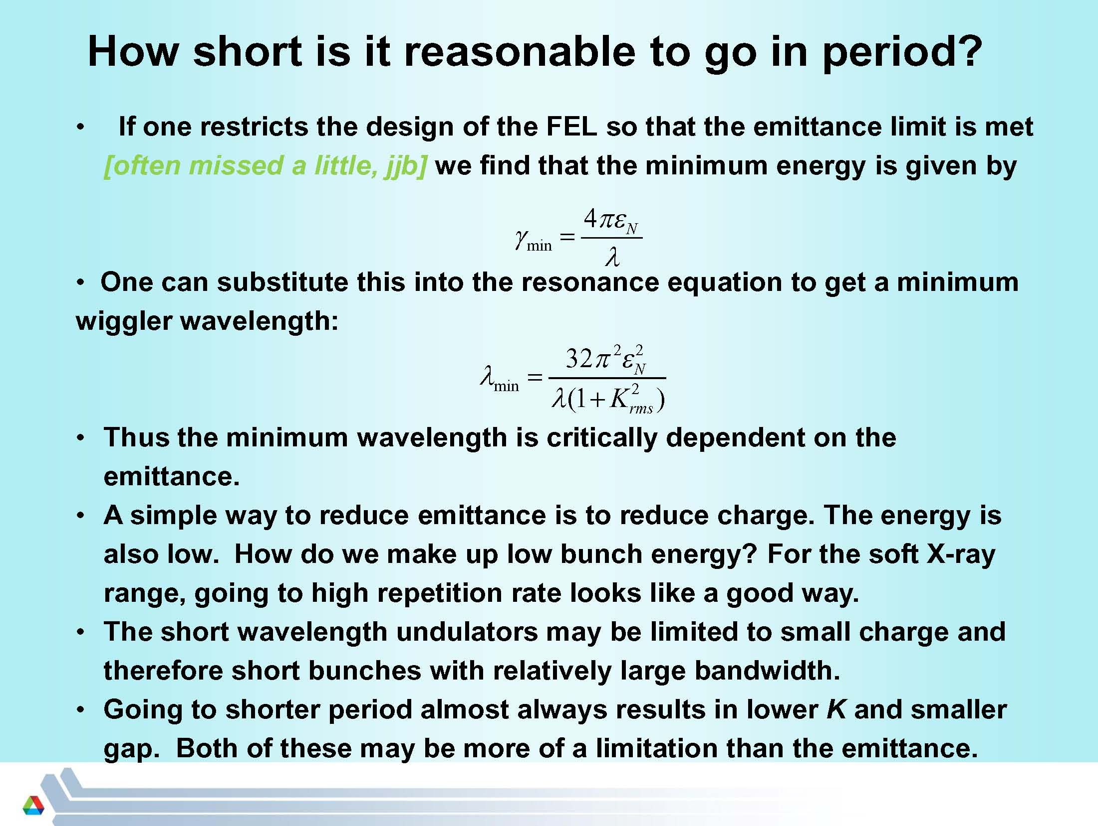

Slide 9
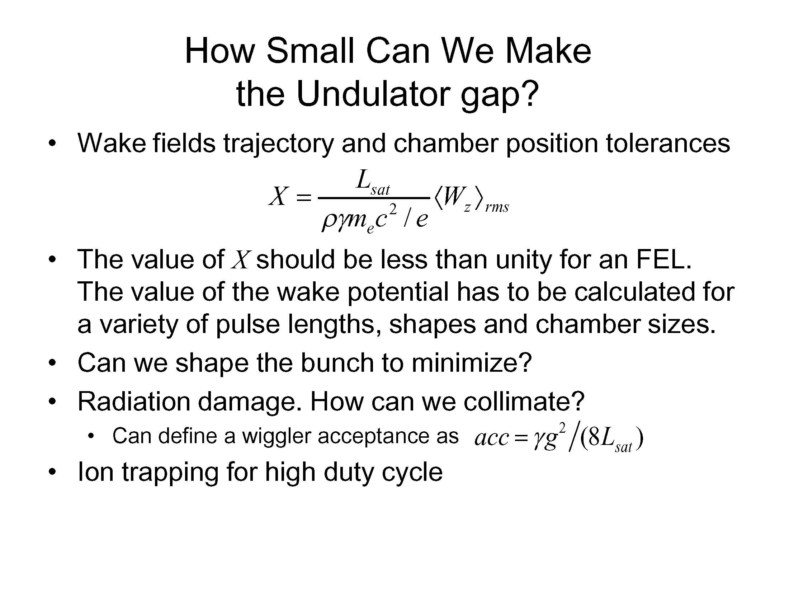

Slide 10
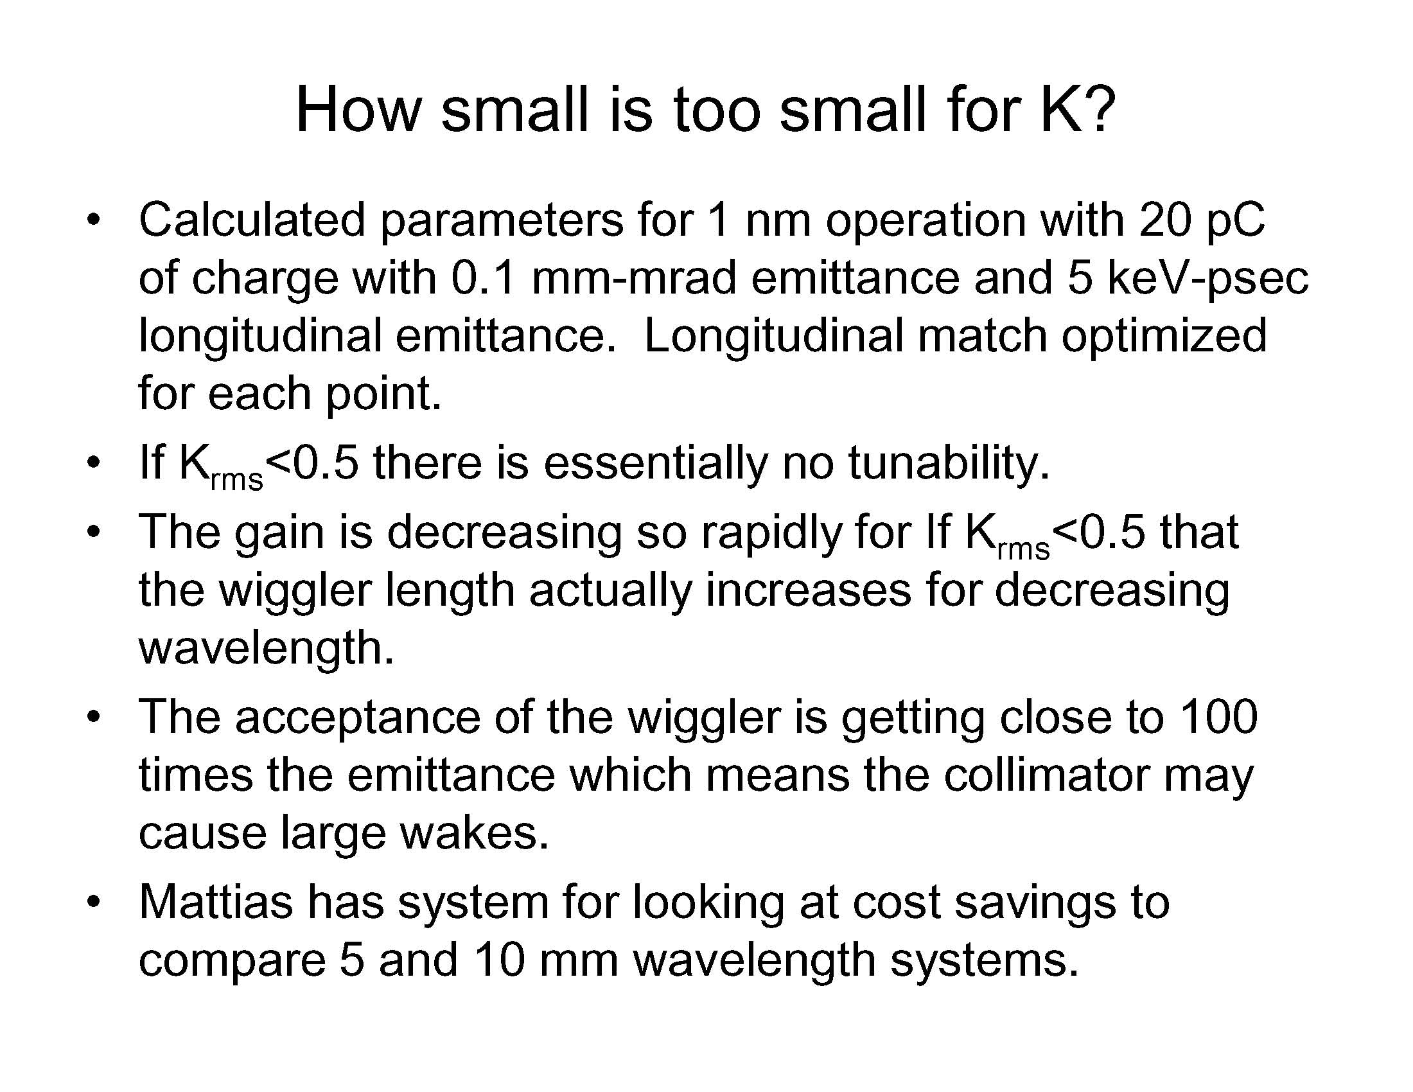

Slide 11
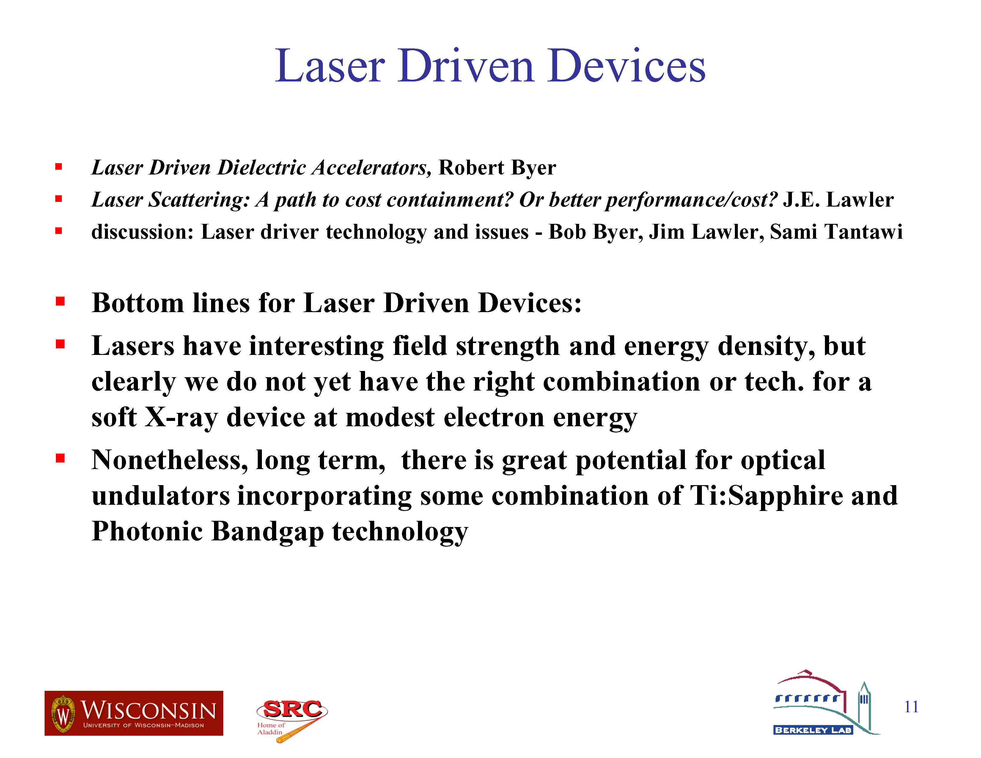

Slide 12
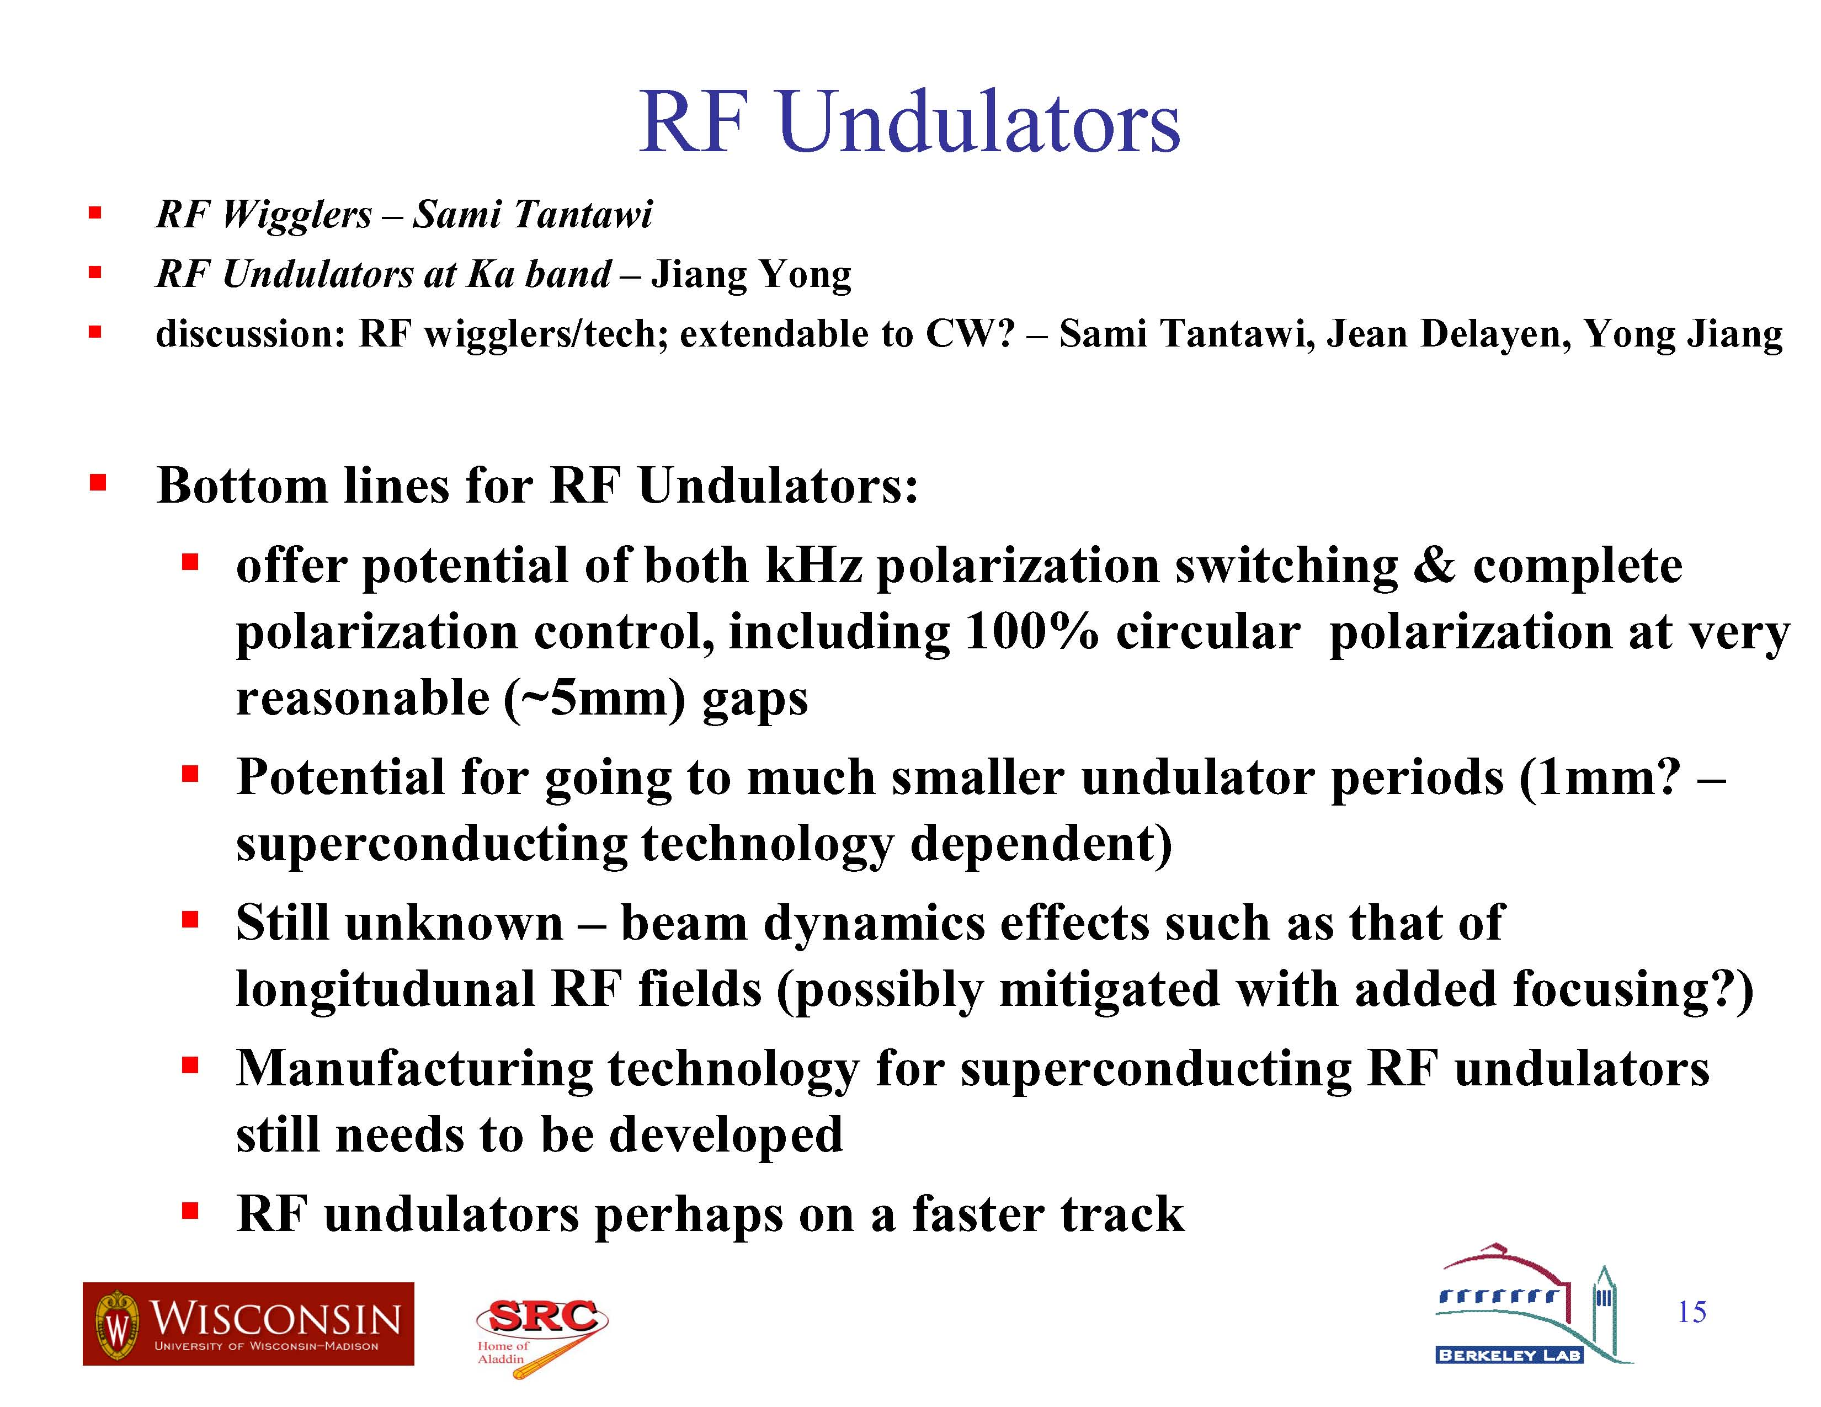

Slide 13
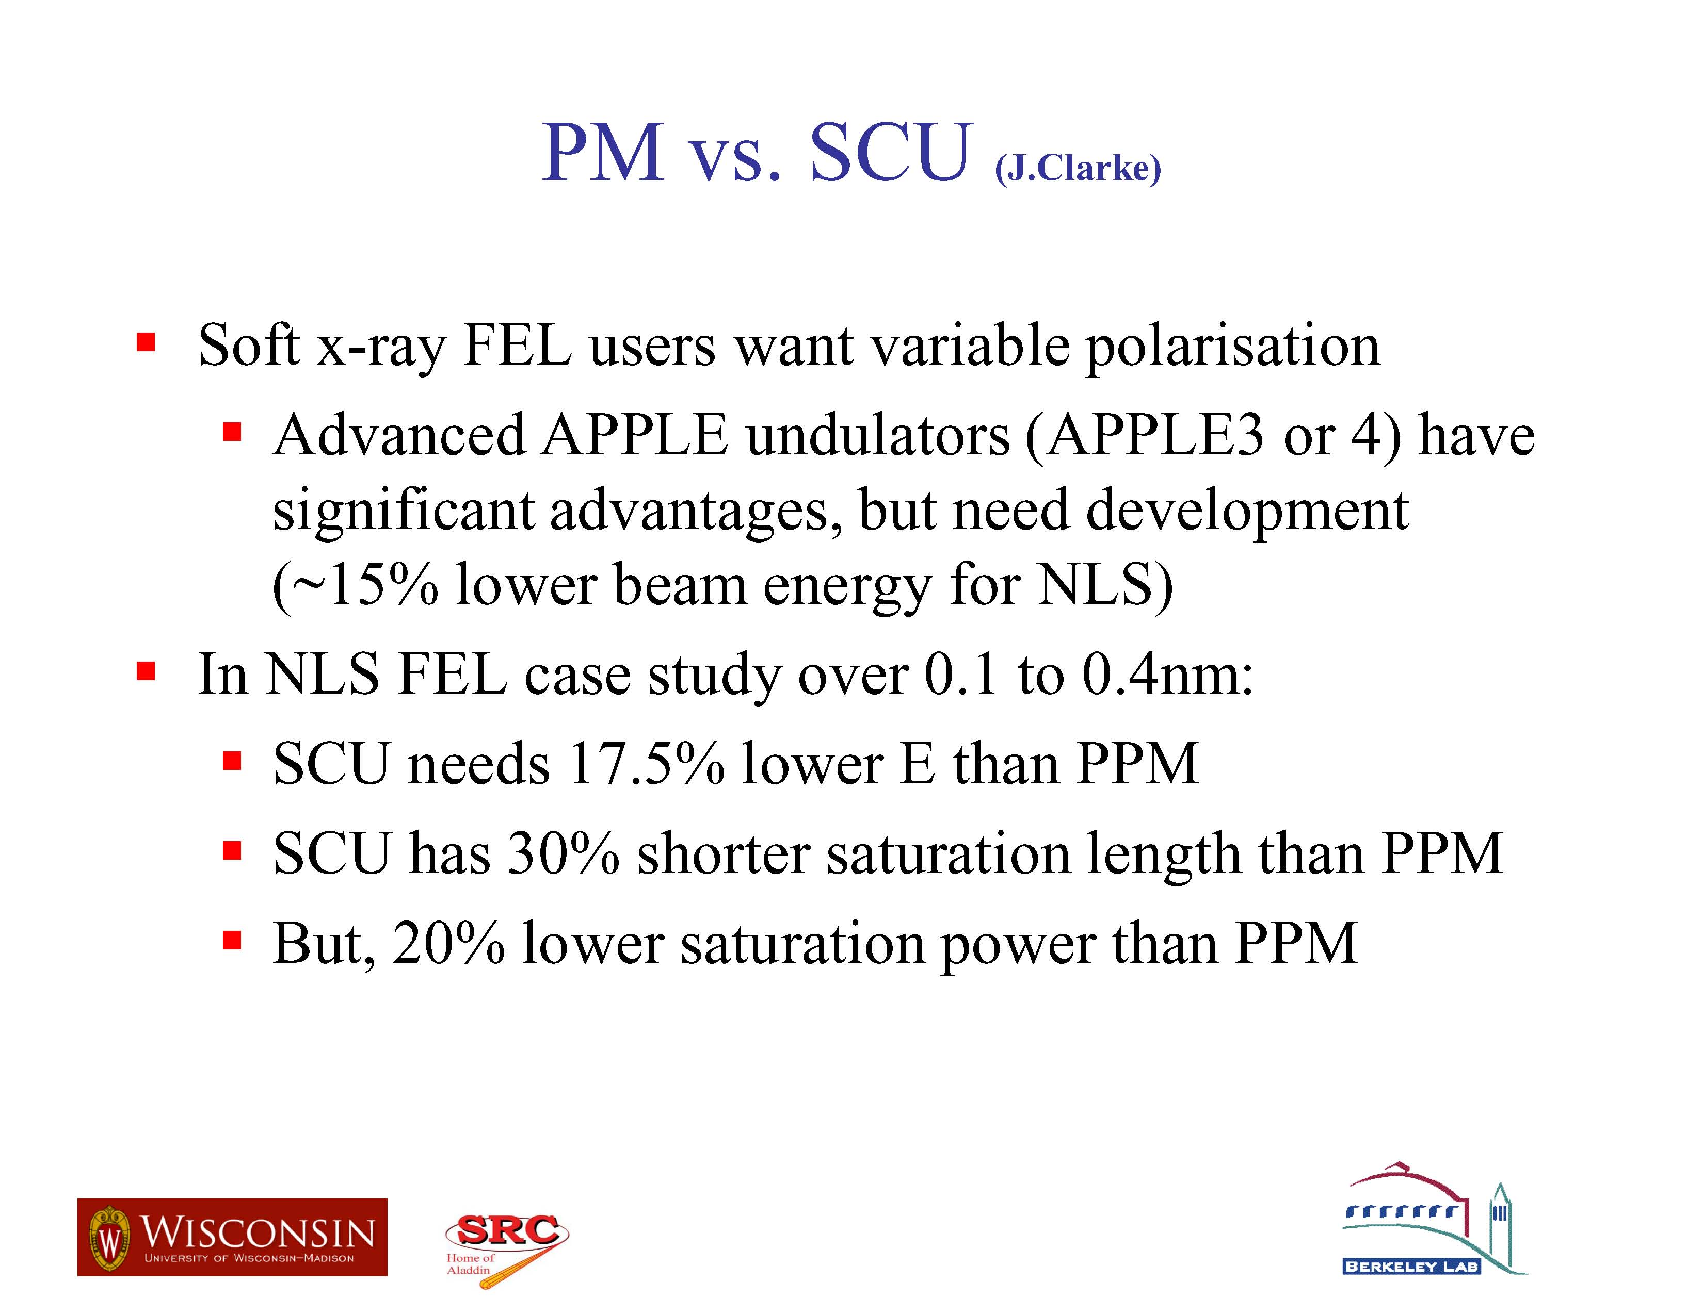

Slide 14
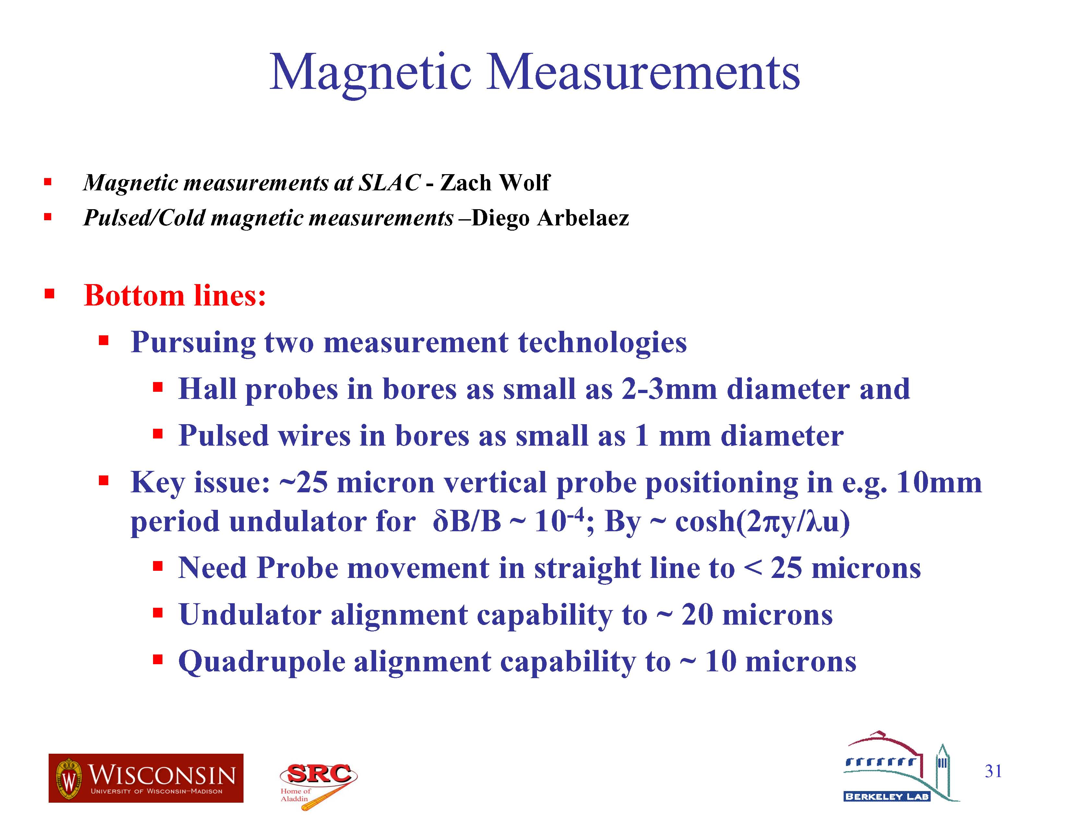
and vibrating

Slide 15


Slide 16
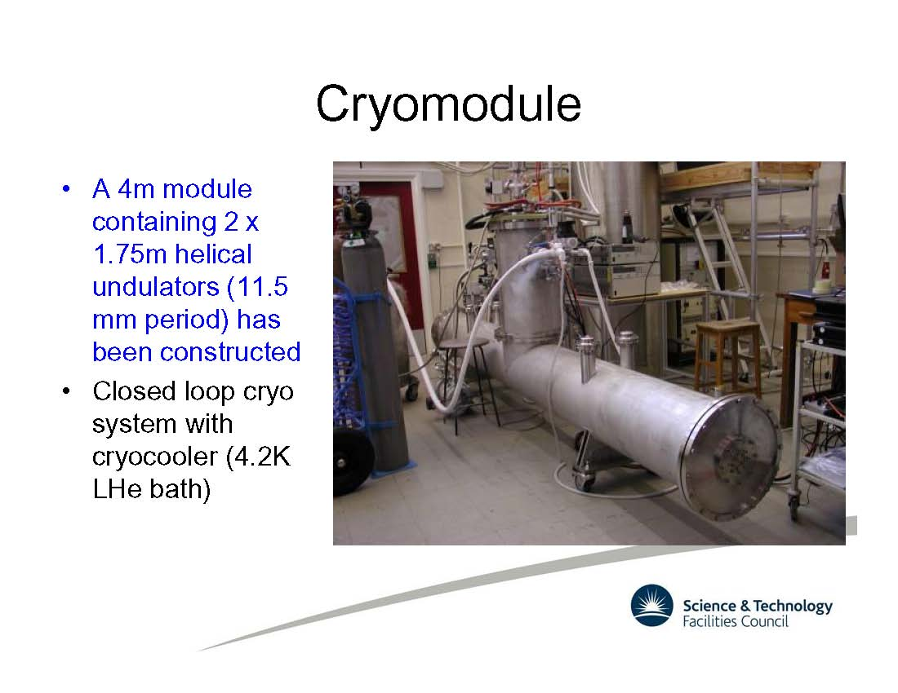
Succeeded in the development of a SC helical undulator (2x1.75 m in one cryostat) for the ILC positron source. Prototype may go to Argonne for beam test.

Slide 17
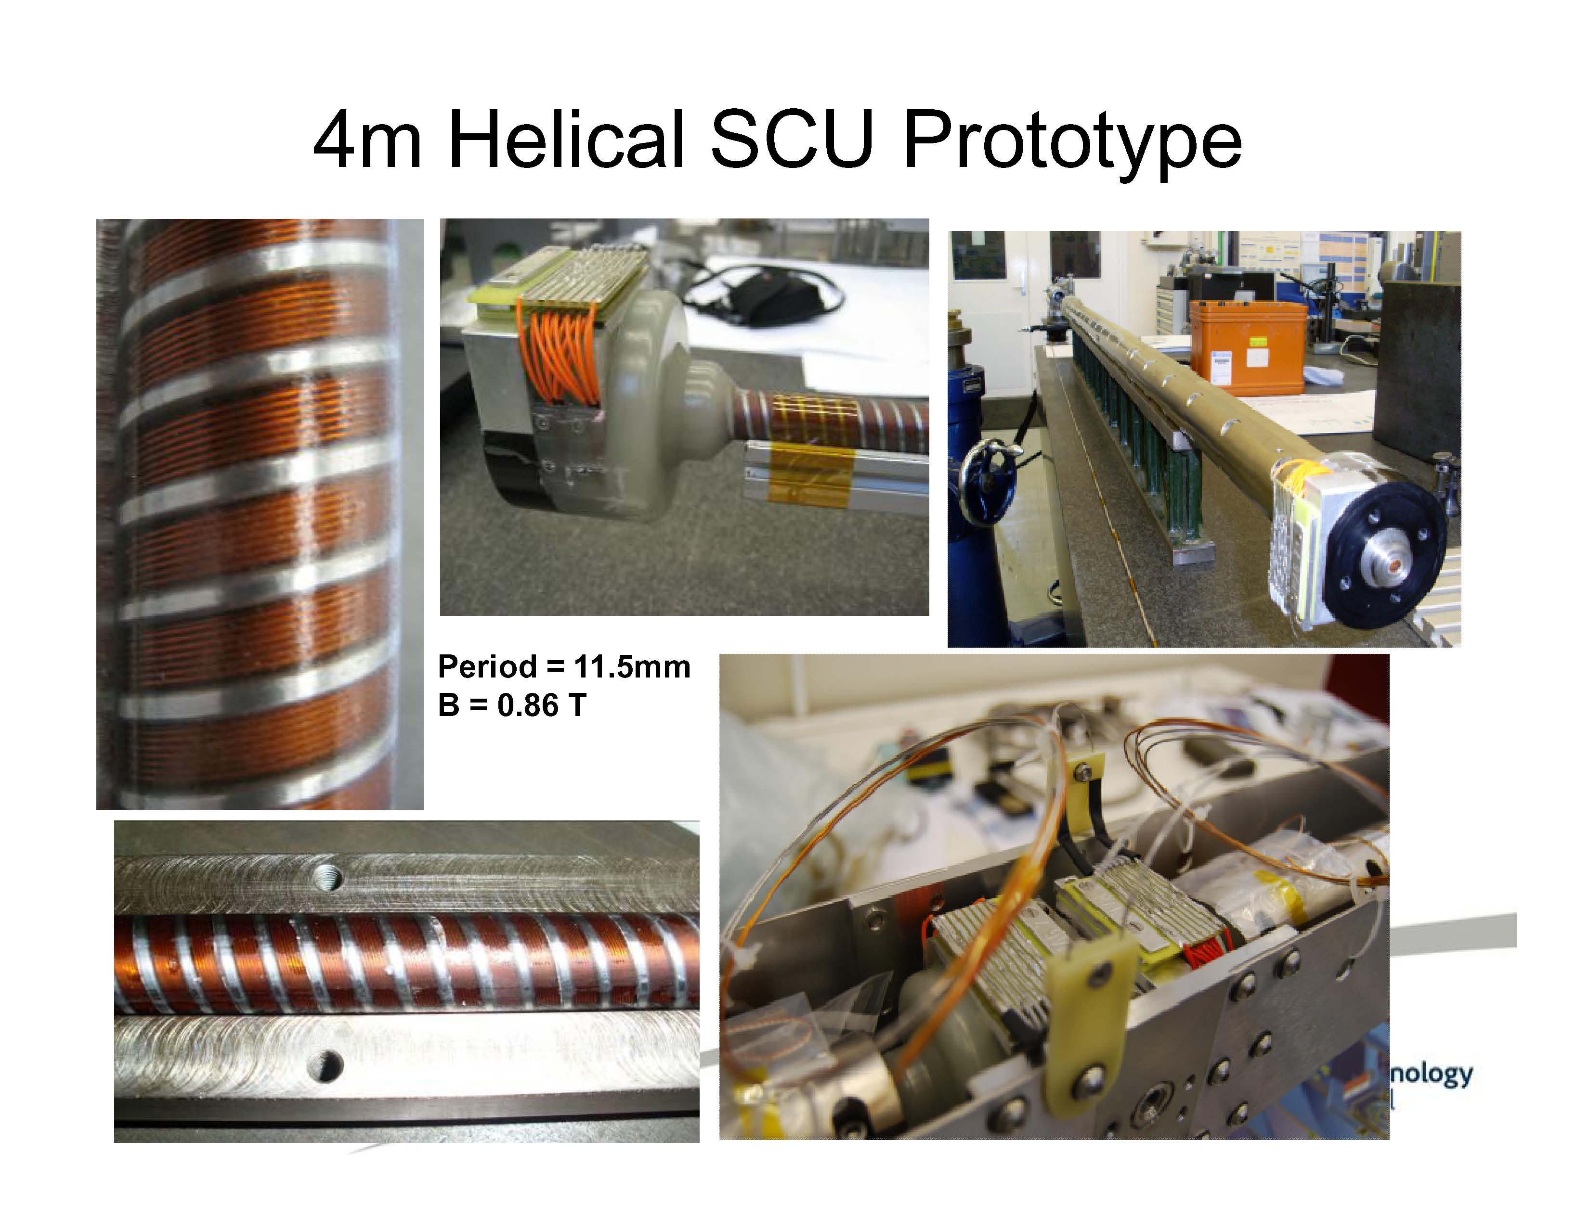

Slide 18
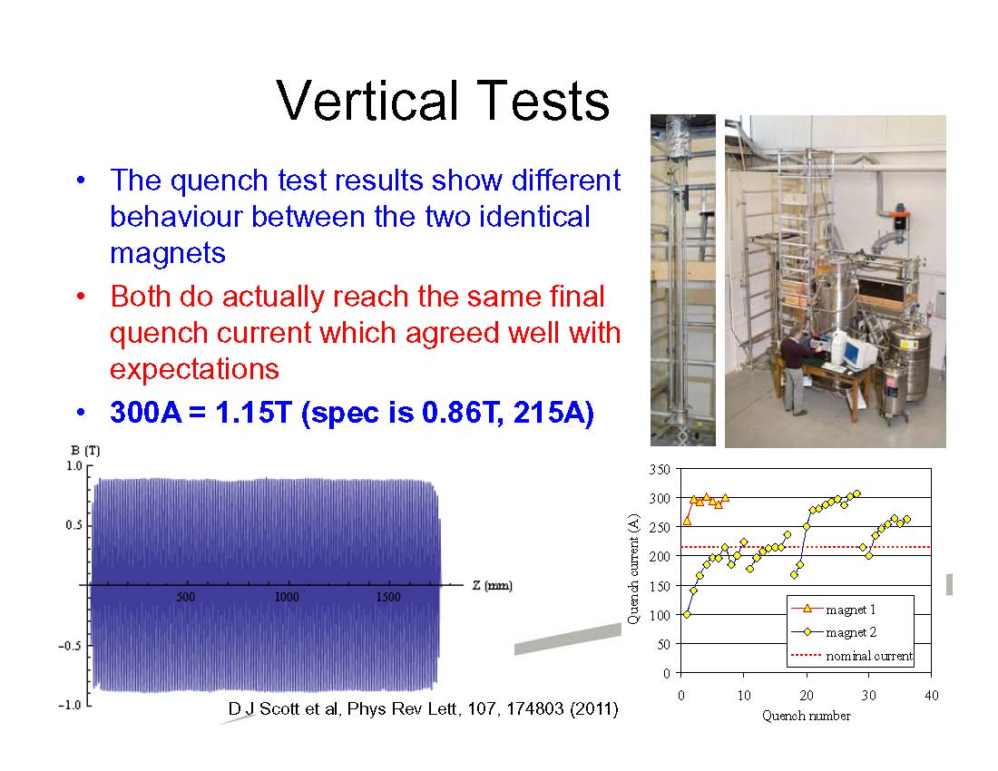

Slide 19
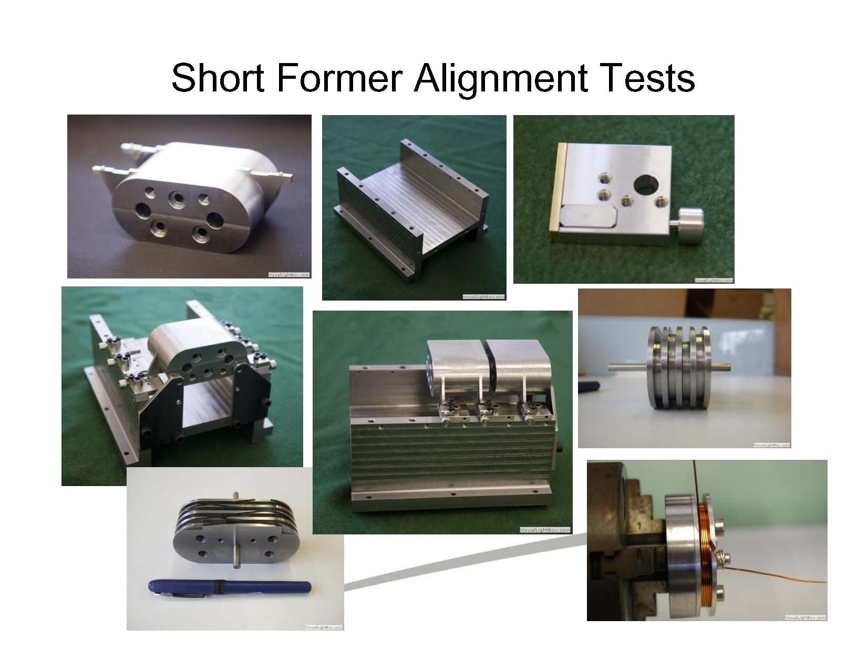
New engineering solution to overcome problem of the structure deformation due to thermo-expansion –> use short (30 cm) sections.

Slide 20
DELTA R&D Project at SLAC
Heinz-Dieter Nuhn – LCLS Undulator Group Leader
Presented at
Monday, March 5, 2012

Slide 21
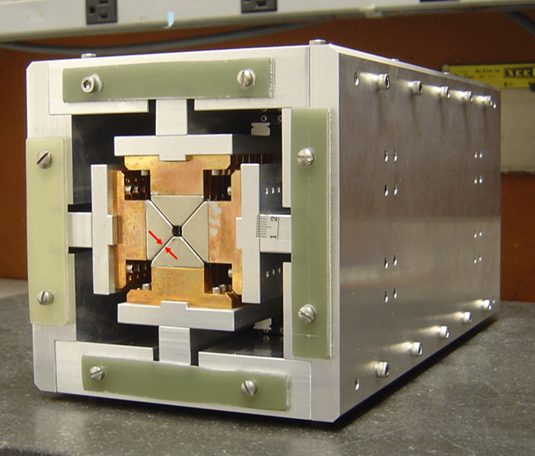
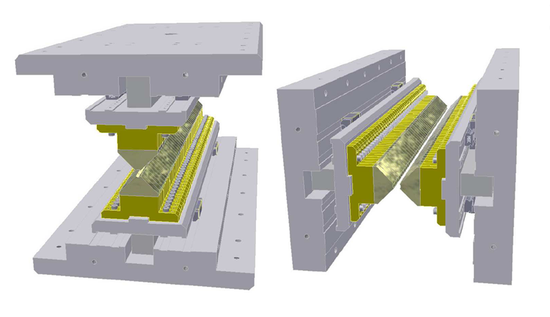
DELTA Undulator Model Developed and Tested at Cornell
Two adjustable phase undulators* assembled in one device**
30 cm long model built in Cornell
Greek Capital Delta Letter
Compact box-like frame (prototype has dimensions ~150mmx150mm)
Full polarization control
Sqrt(2) stronger field in planar mode and ~2X stronger in helical mode in compare with conventional Apple II type undulators.
Project was motivated by the Cornell ERL needs.
*R. Carr, Adjustable phase insertion devices as X-ray sources, Nucl. Instr. And Meth. A 306(1991) 391-396
**A. Temnykh, Delta undulator for Cornell energy recovery linac , Phys. Rev. ST Accel. Beams 11, 120702 (2008)

Slide 22
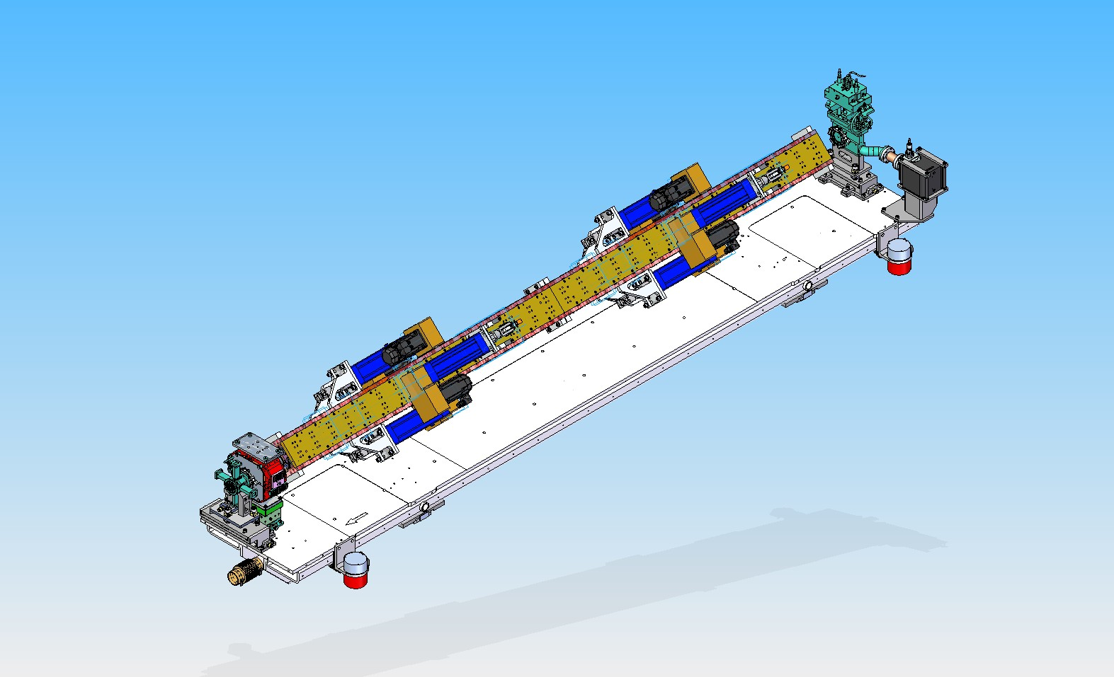
Isometric View – Installed on Girder in SLAC
Period 32 mm, Length 3.2m
Gap (bore) 6.4mm
PM material NdFeB, grade N40UH
Beam Direction

Slide 23
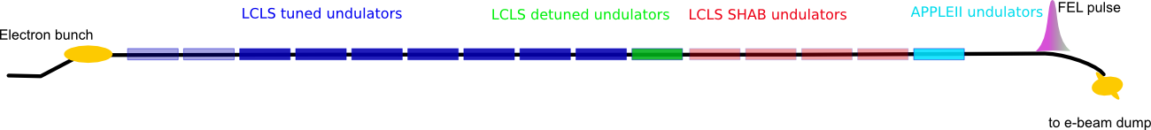
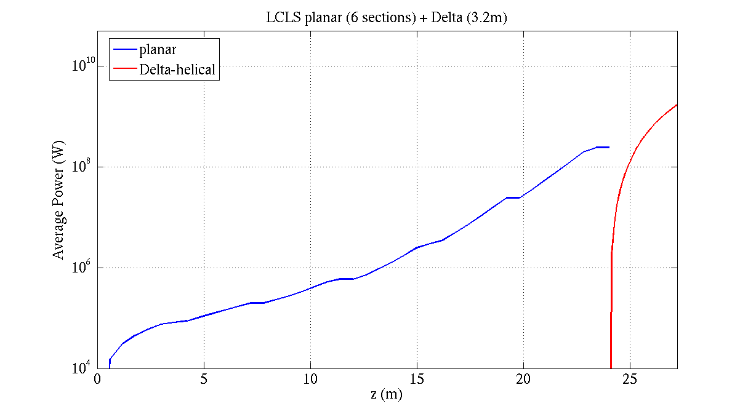
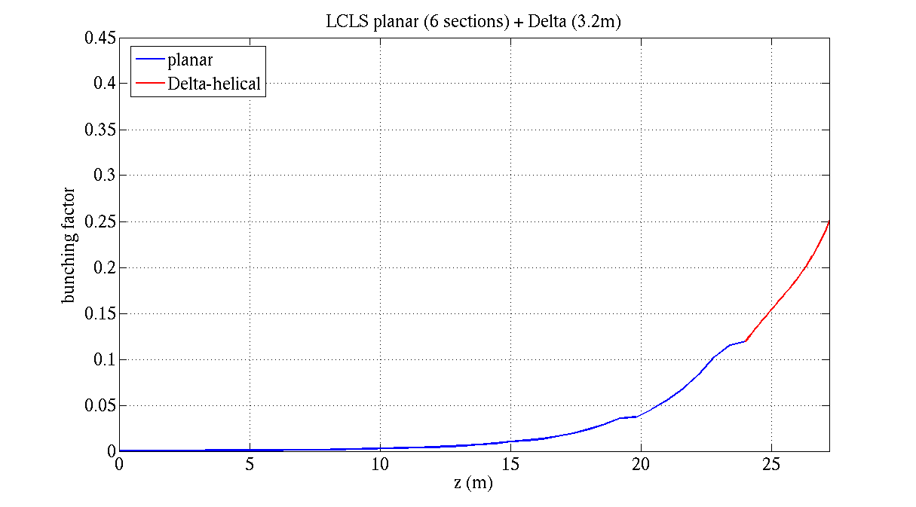
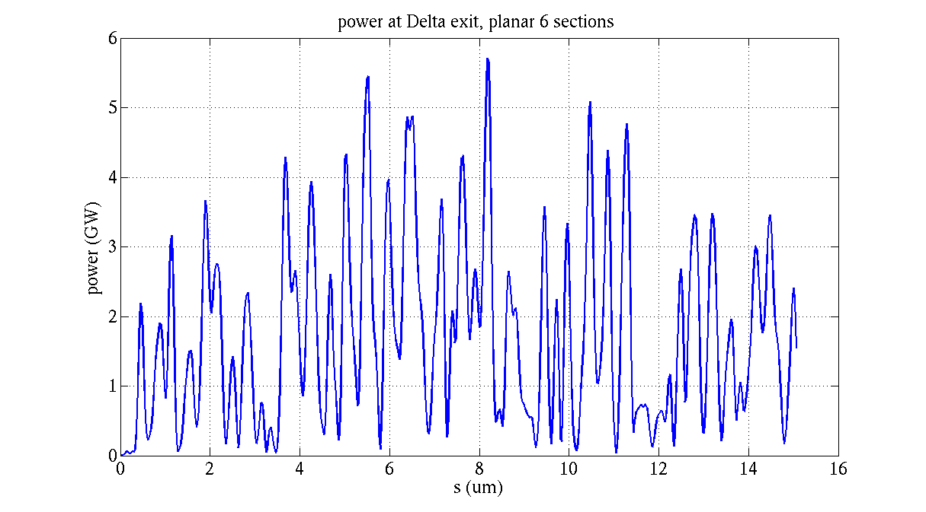
GENESIS 1.3: 830eV, 2kA, 6 planar sections + Delta 3.2 m
LCLS planar undulators
Delta, helical
Circular polarization : 87%. planar power 0.24 GW,
circular power 1.7 GW
Yuantao Ding

Slide 24
Radiation Monitoring at the
Undulator System
Heinz-Dieter Nuhn – LCLS Undulator Group Leader
Presented at
Wednesday, March 7, 2012

Slide 25
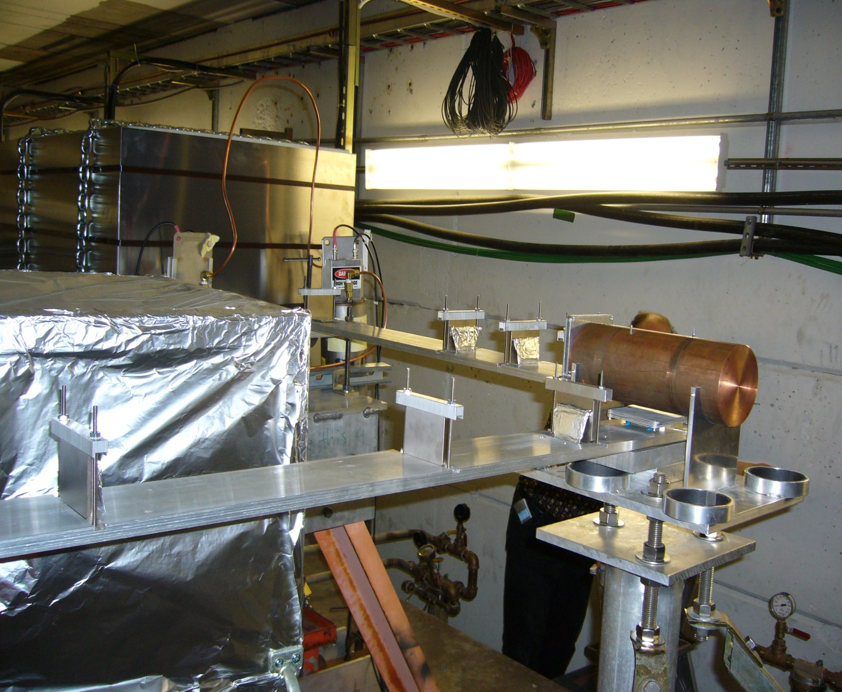
T-493 Components installed in ESA Beamline
ESA Beamline with copper cylinder and magnet blocks.
BEAM
Photo courtesy of J. Bauer

Slide 26
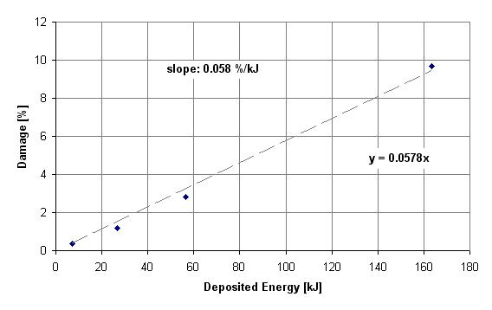
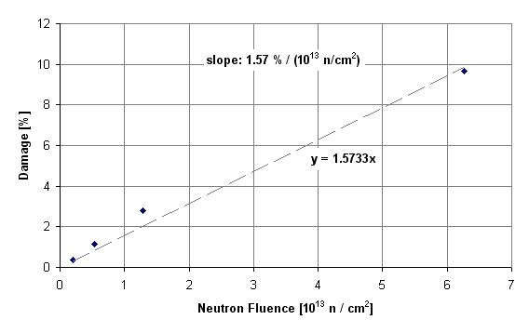
Damage Gradients
M1
M1
M2
M2
M4
M3
M4
M3
Threshold Estimates for 0.01 % Damage
Source | Deposited Energy | Dose | Dose | Neutron Fluence
T-493 | 0.17 kJ | 0.70 kGy | 0.070 MRad | 0.64×10¹¹ n/cm²
Threshold Estimates for 1 % Damage
Source | Deposited Energy | Dose | Dose | Neutron Fluence
T-493 | 17 MJ | 70 kGy | 7 MRad | 6.4×10¹² n/cm²
FLASH Experimental Result: 20 kGy cause 1% Damage

Slide 27
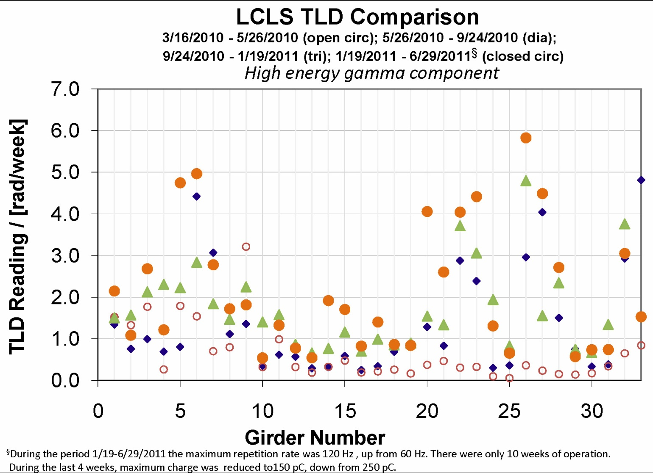
2011 Repetition Rate increased to 120 Hz
3/16/2010 – 5/26/2010
5/26/2010 – 9/24/2010
9/24/2010 – 1/19/2011
1/19/2011 – 6/29/2011
Thermo-Luminescent Dosimeters
Each TLD mounted in 1.6-mm thick Pb-casing to suppress photons below ~200 keV
External neutron doses are very small: (U01: 0.04-0.05 rad/week; U33: ~0 rad/week)
LCLS radiation level control works well.

Slide 28
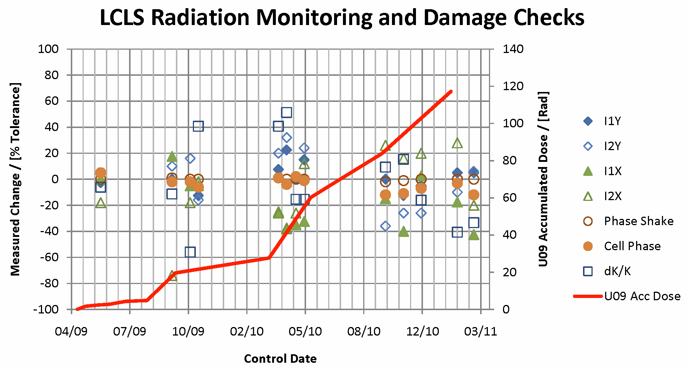
Changes in Undulator Properties After Beam Operation
Lifetime estimates for 120 Hz operation is in access of 100 year. Scaled to 1 MHz operation makes this a problem that needs to be addressed.

Slide 29
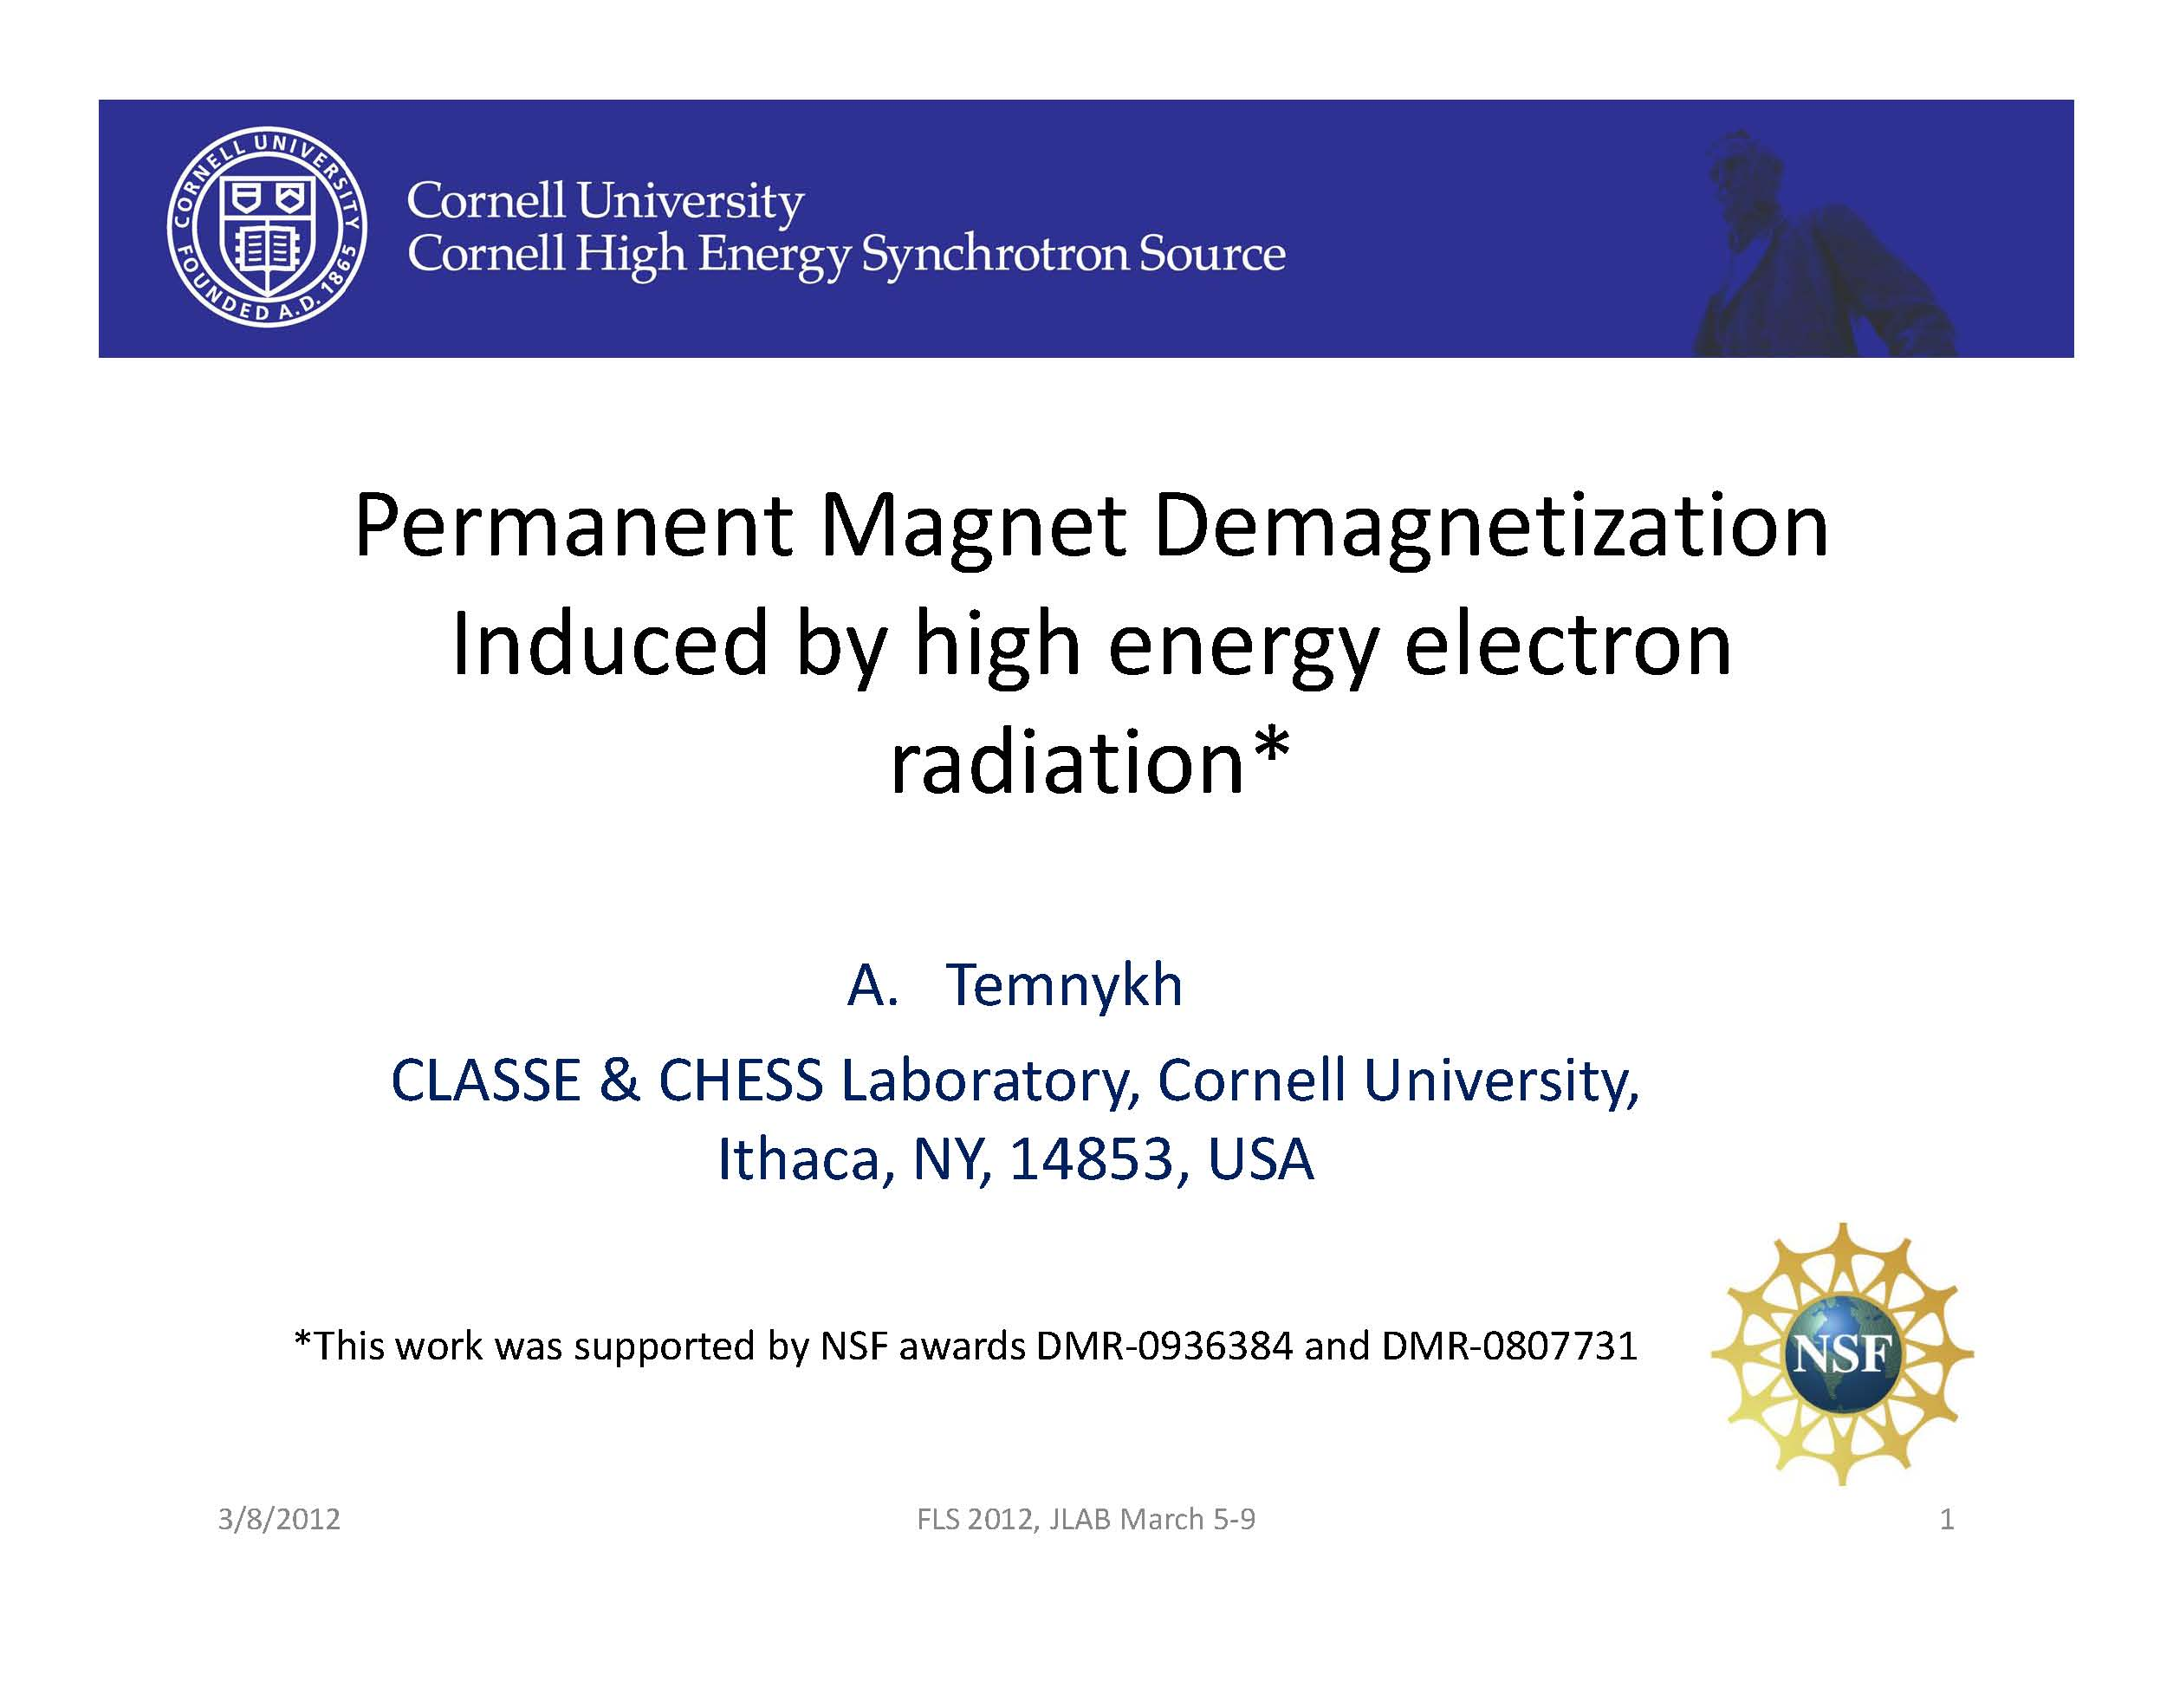

Slide 30
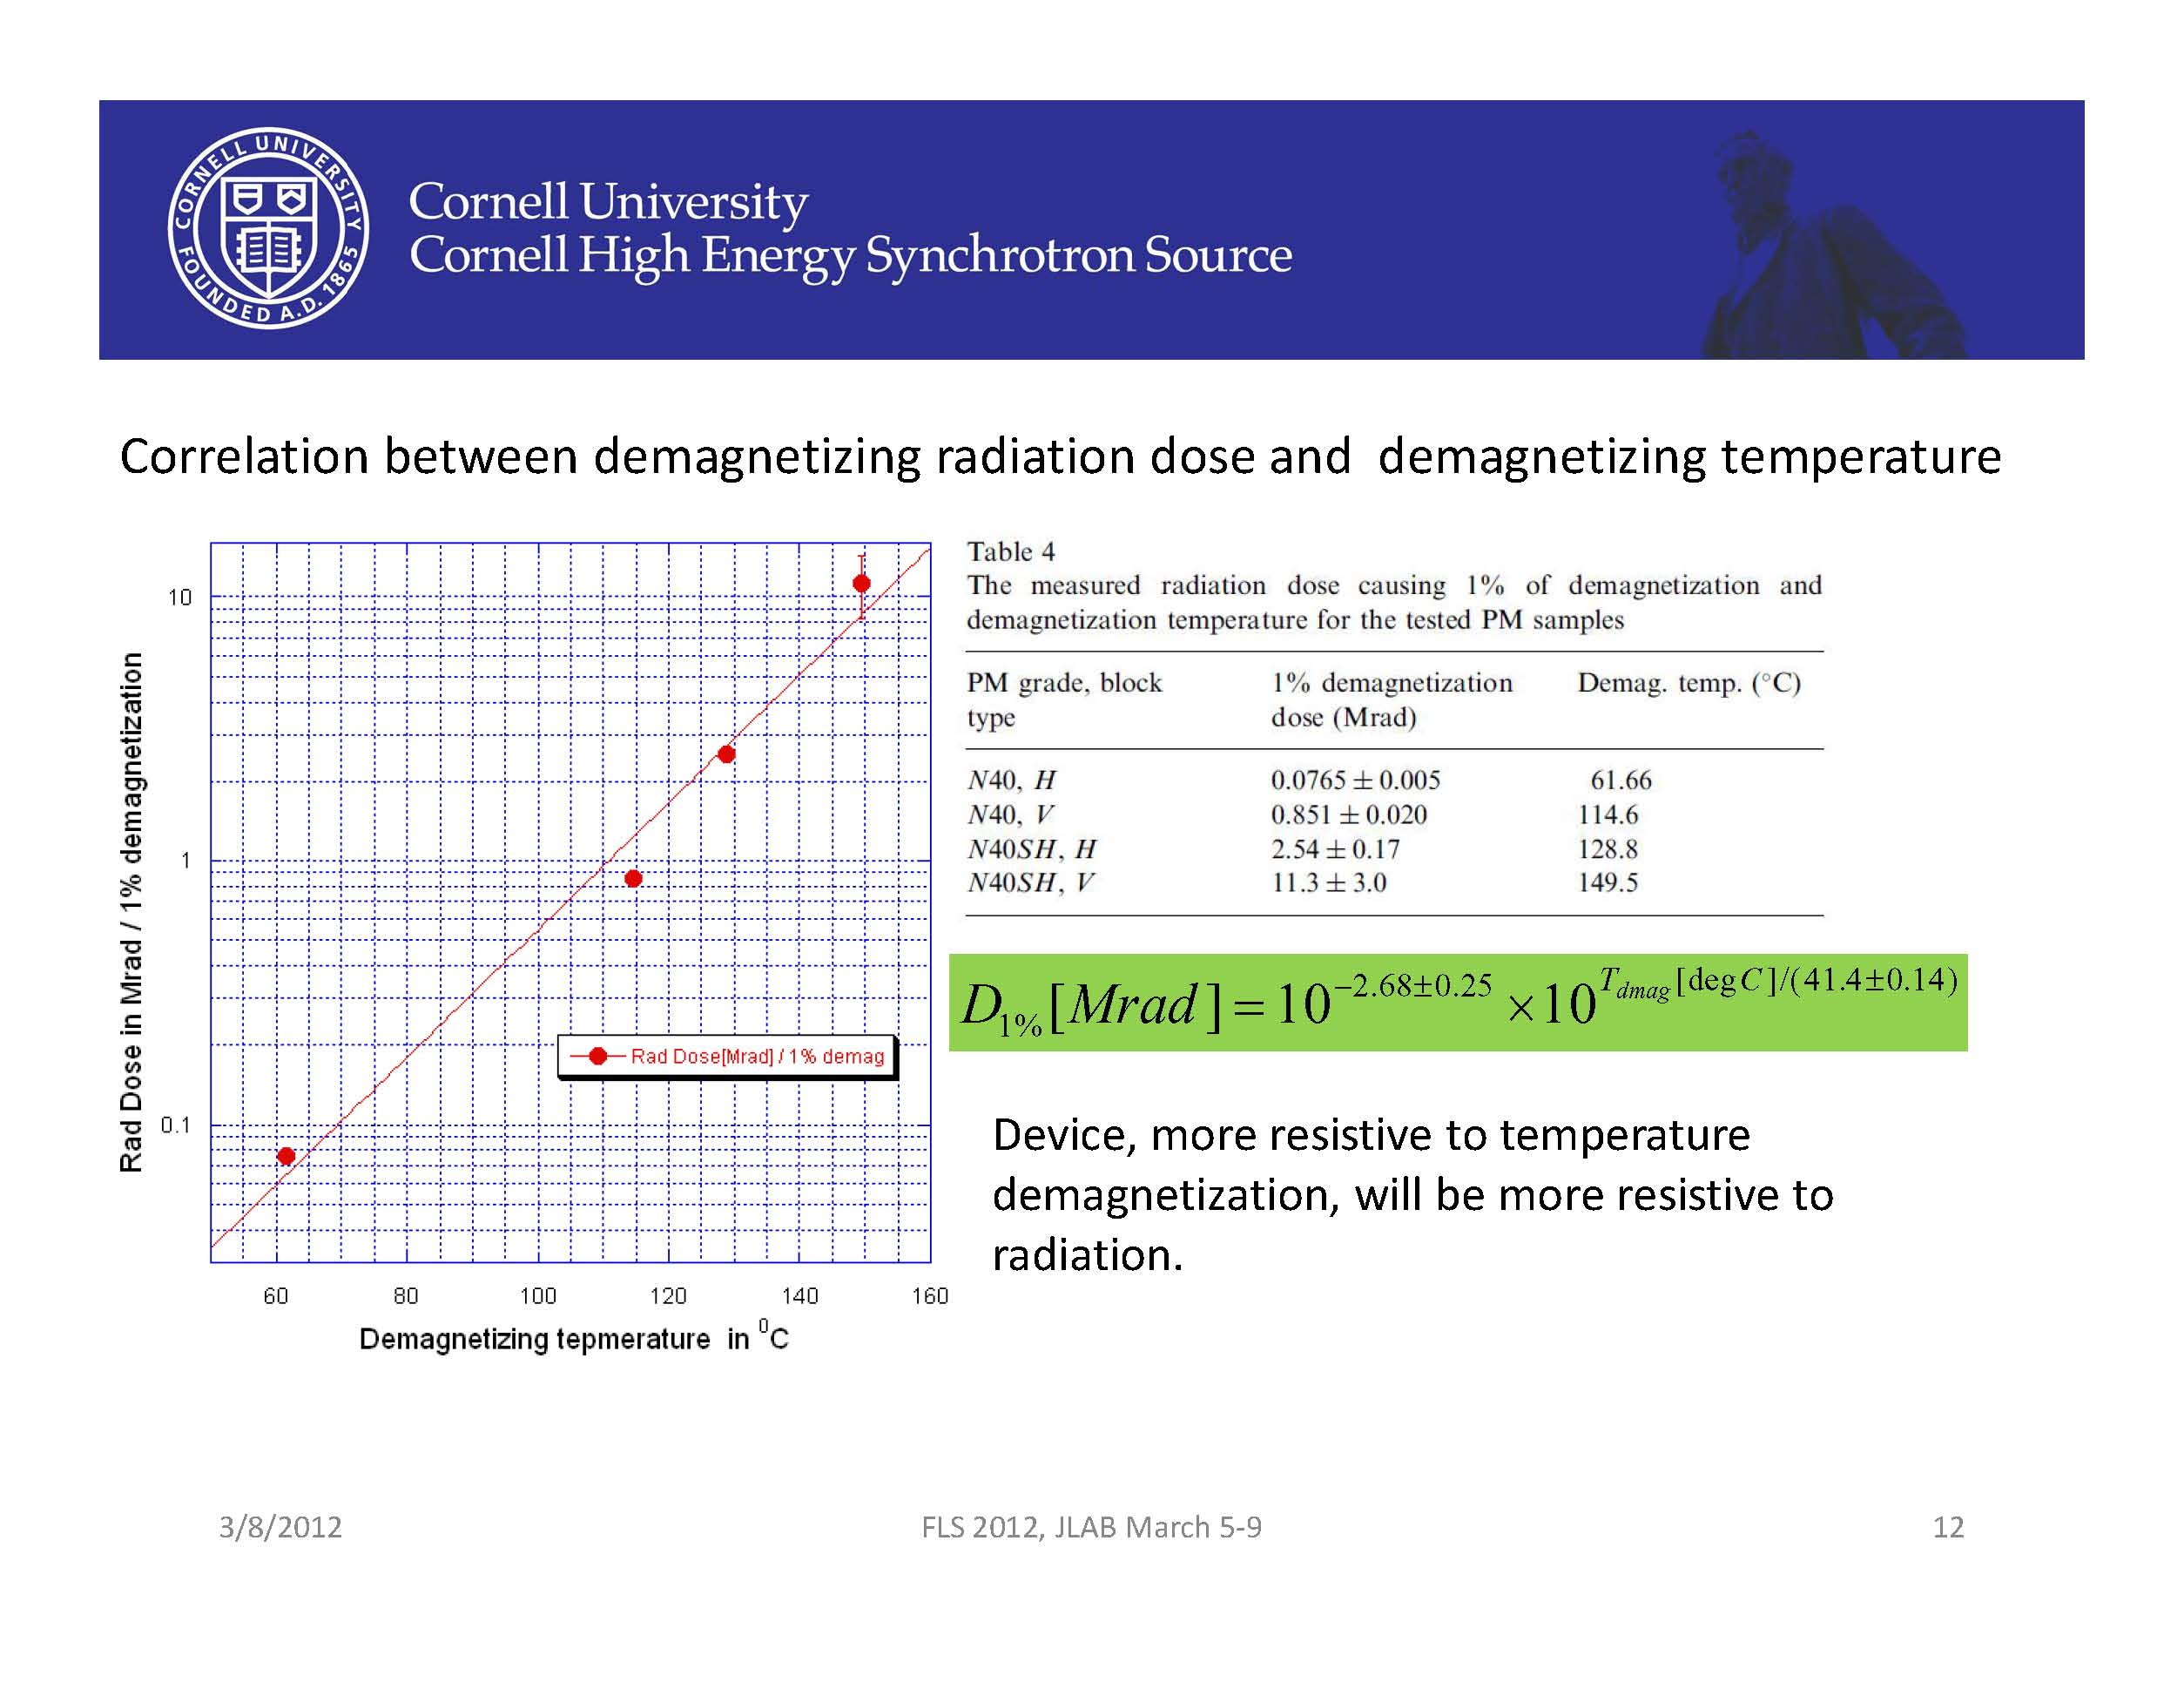

Slide 31
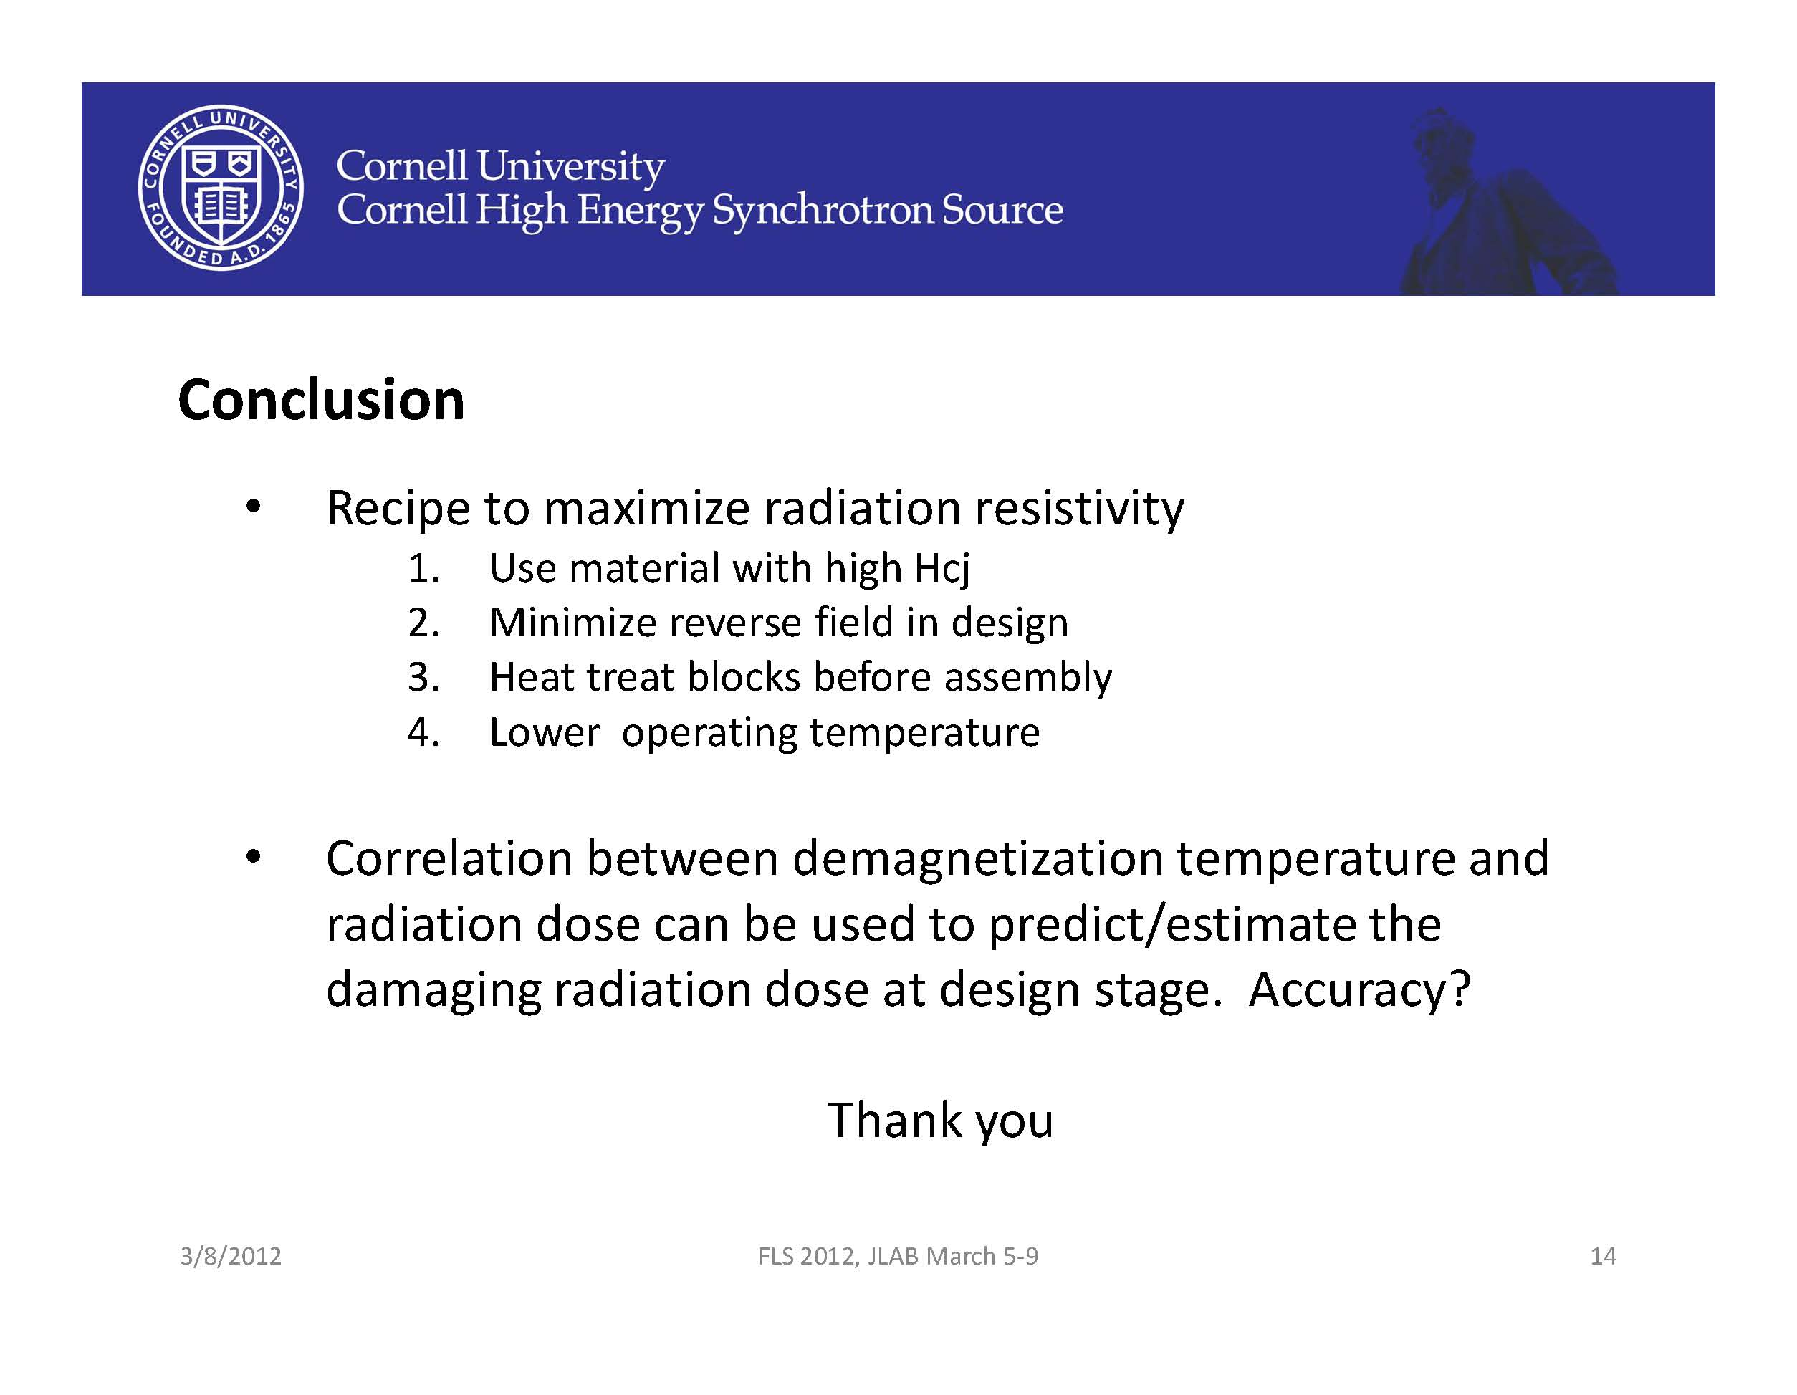

Slide 32
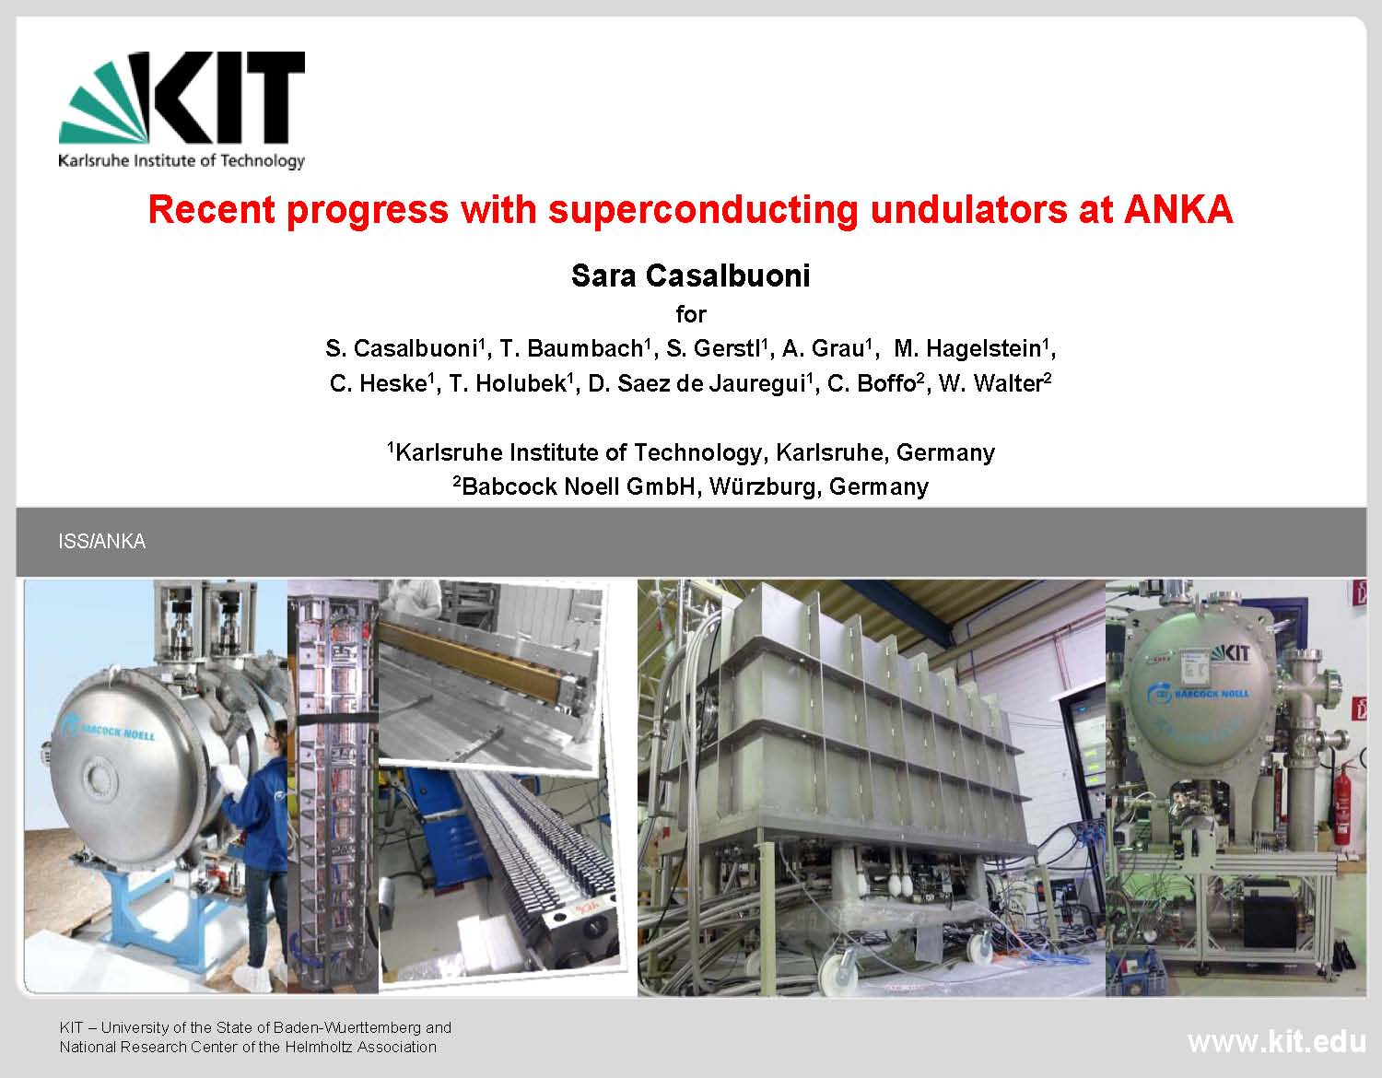

Slide 33
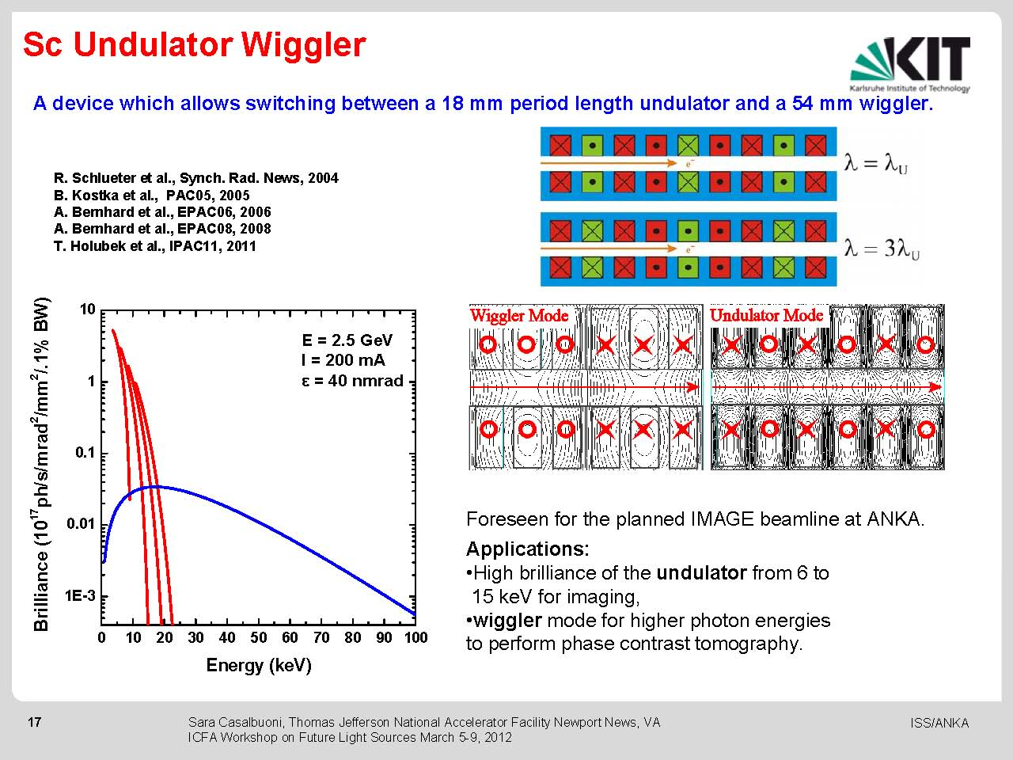

Slide 34
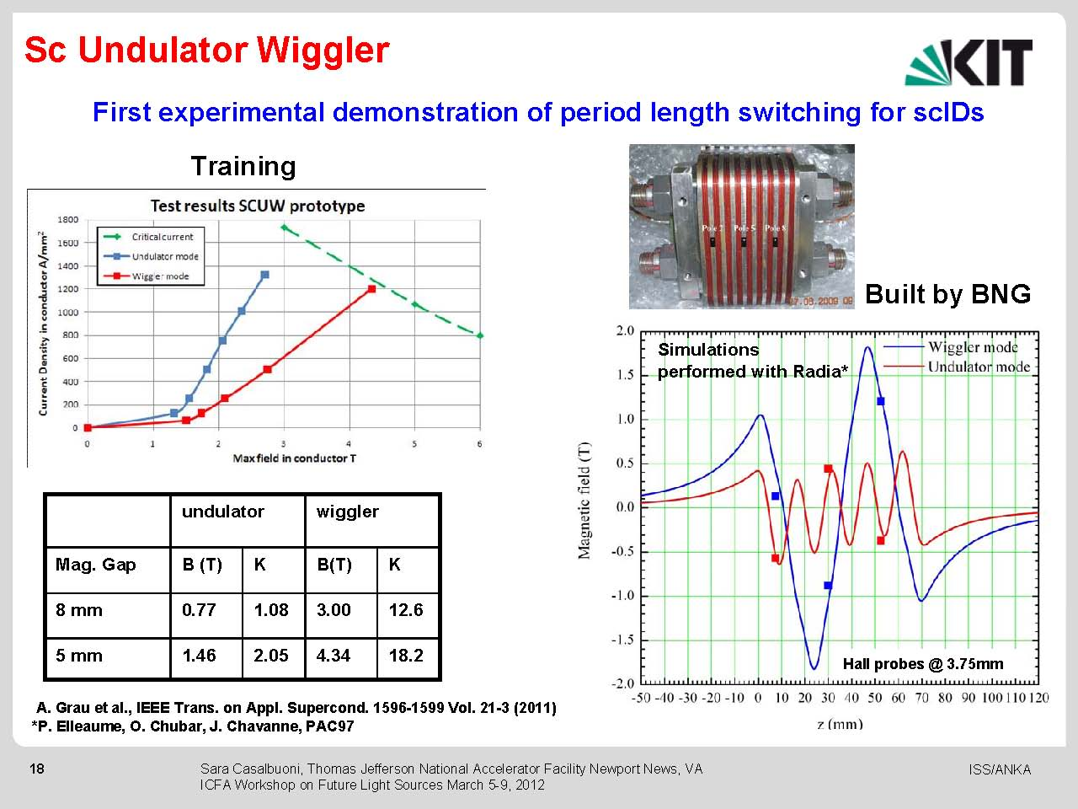

Slide 35
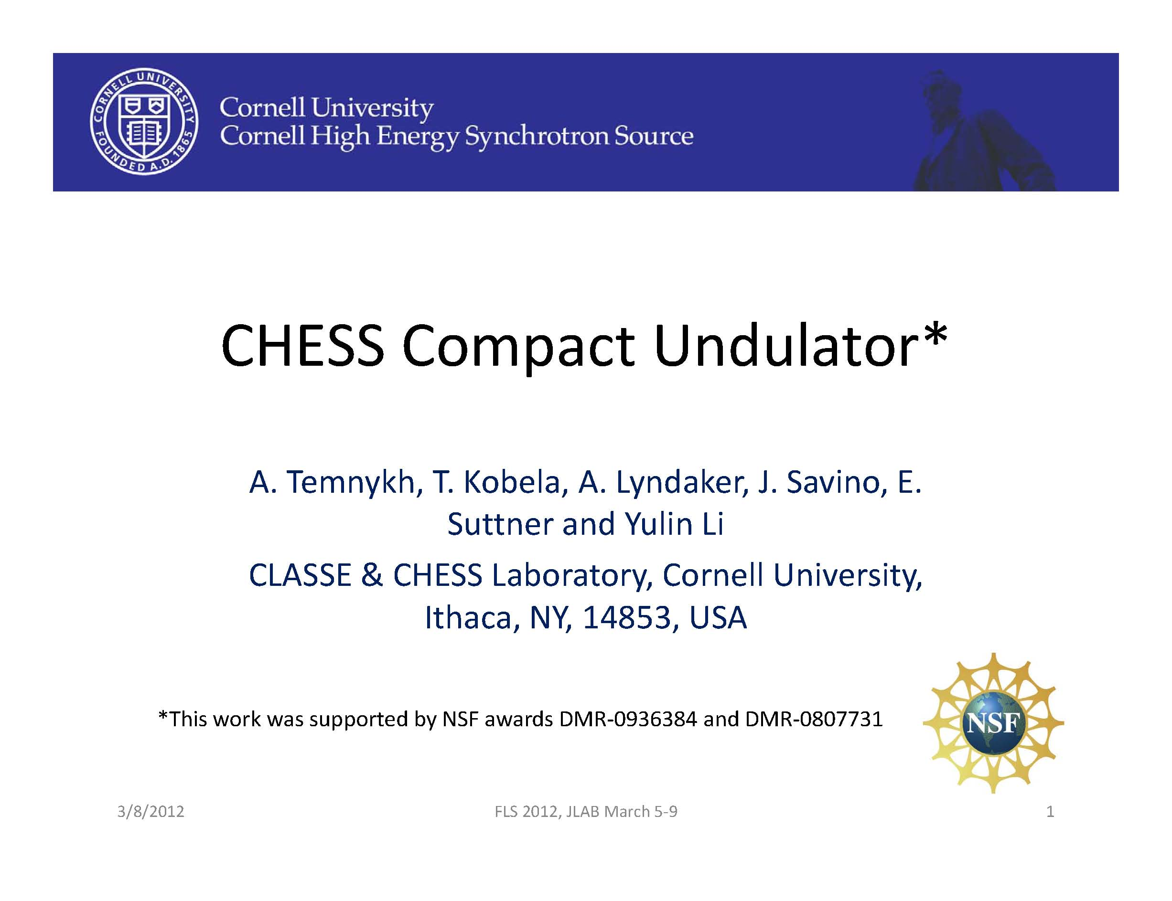

Slide 36
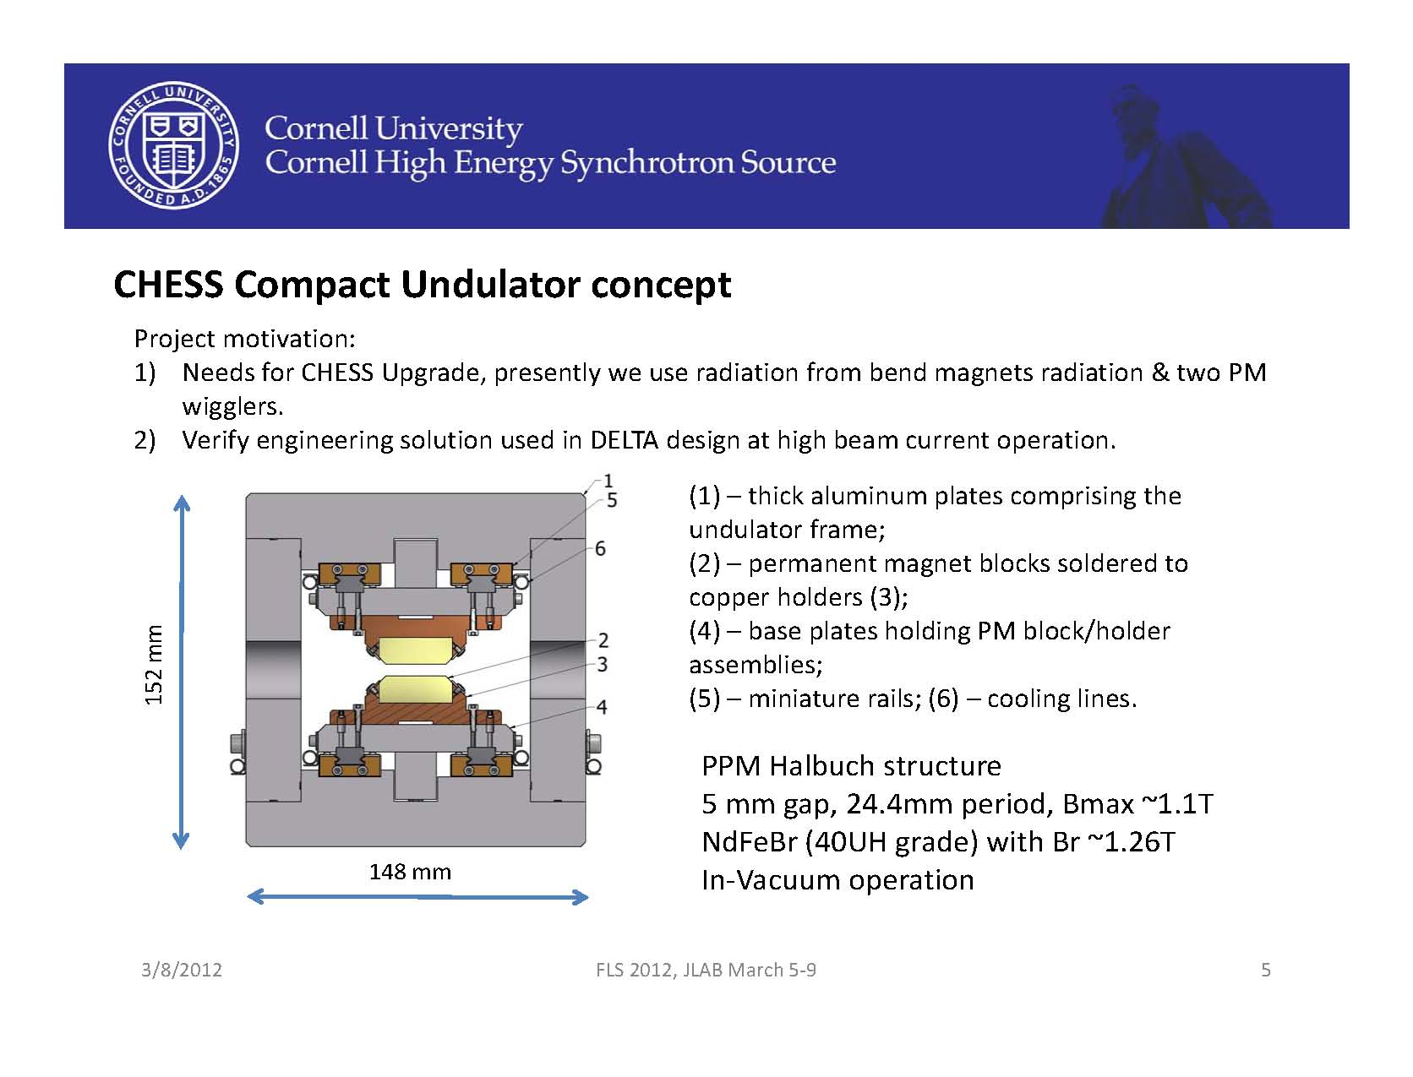
- Adjustable Phase Undulator (APU)

Slide 37
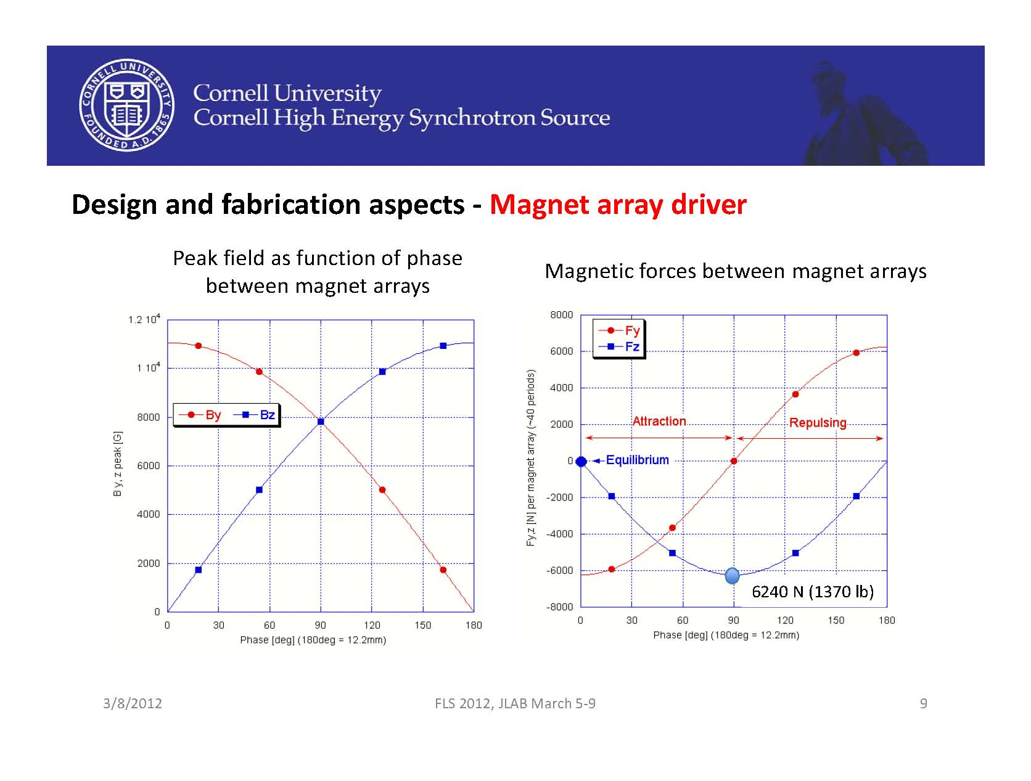

Slide 38
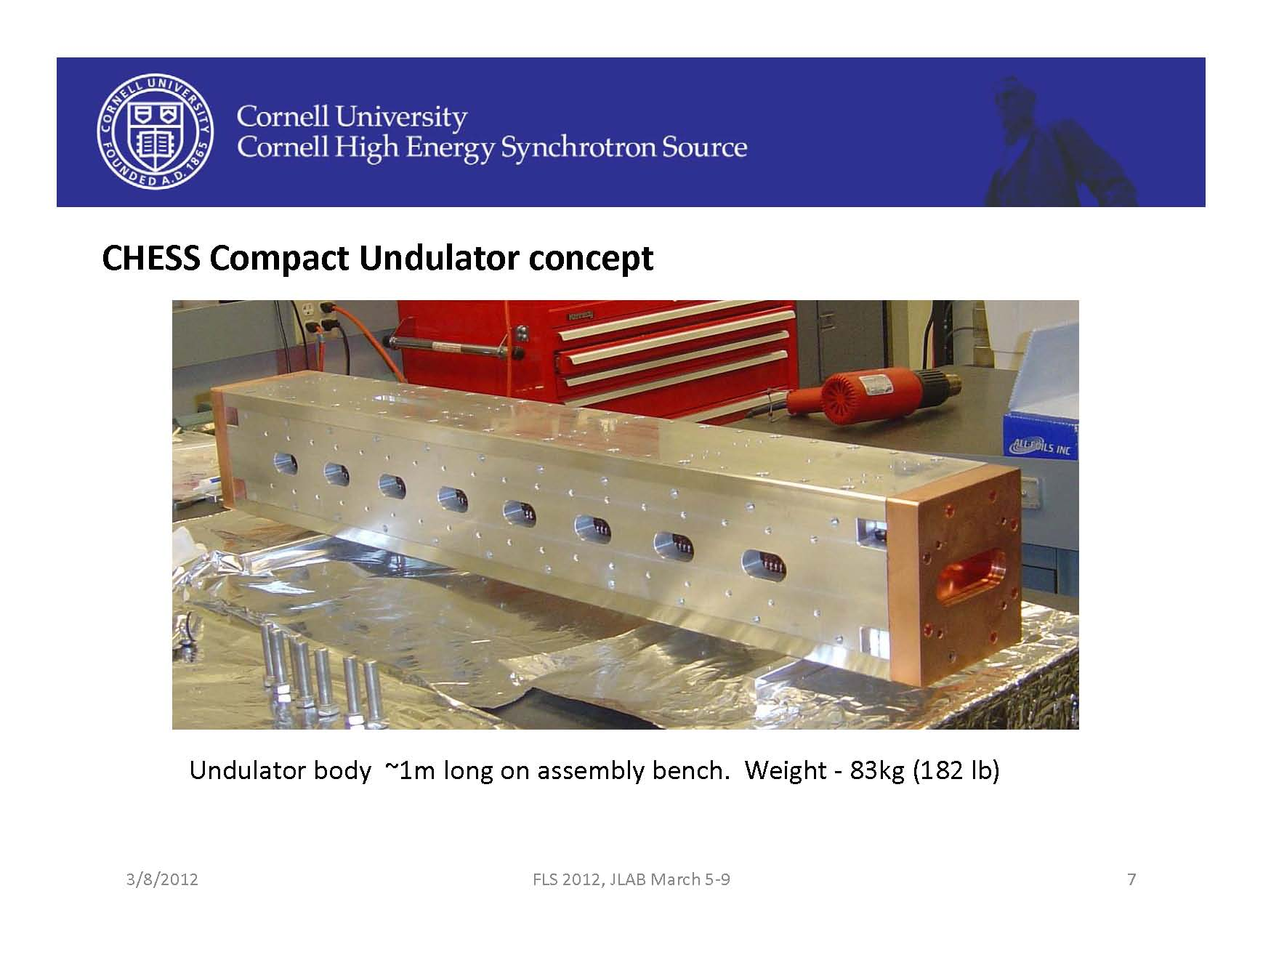

Slide 39
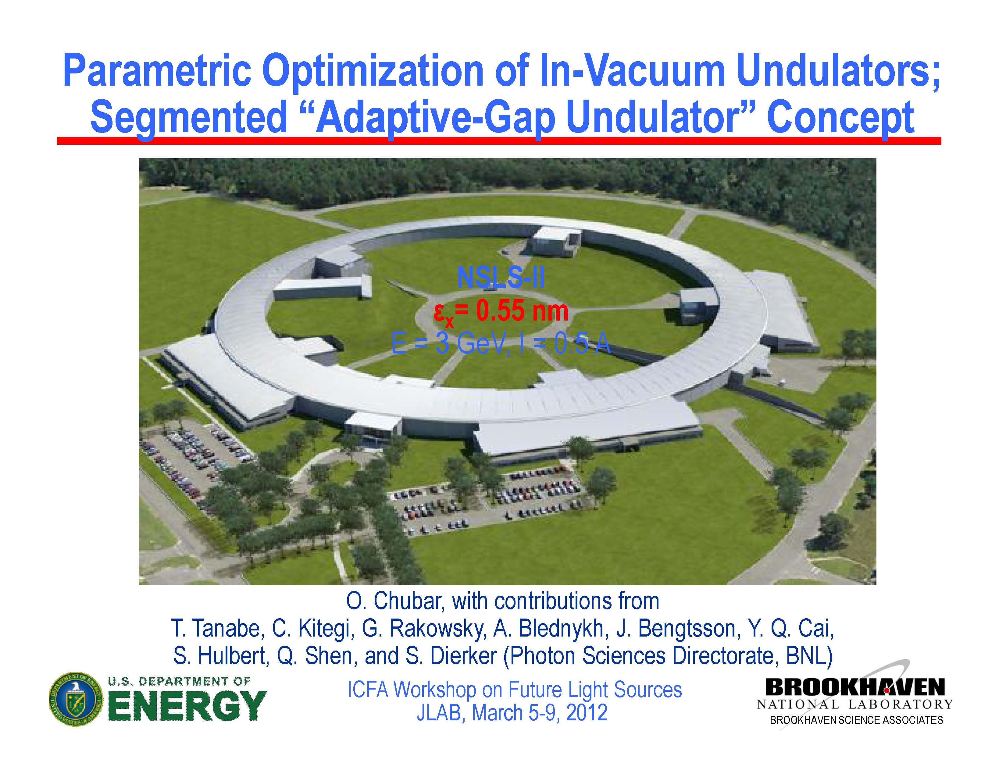

Slide 40
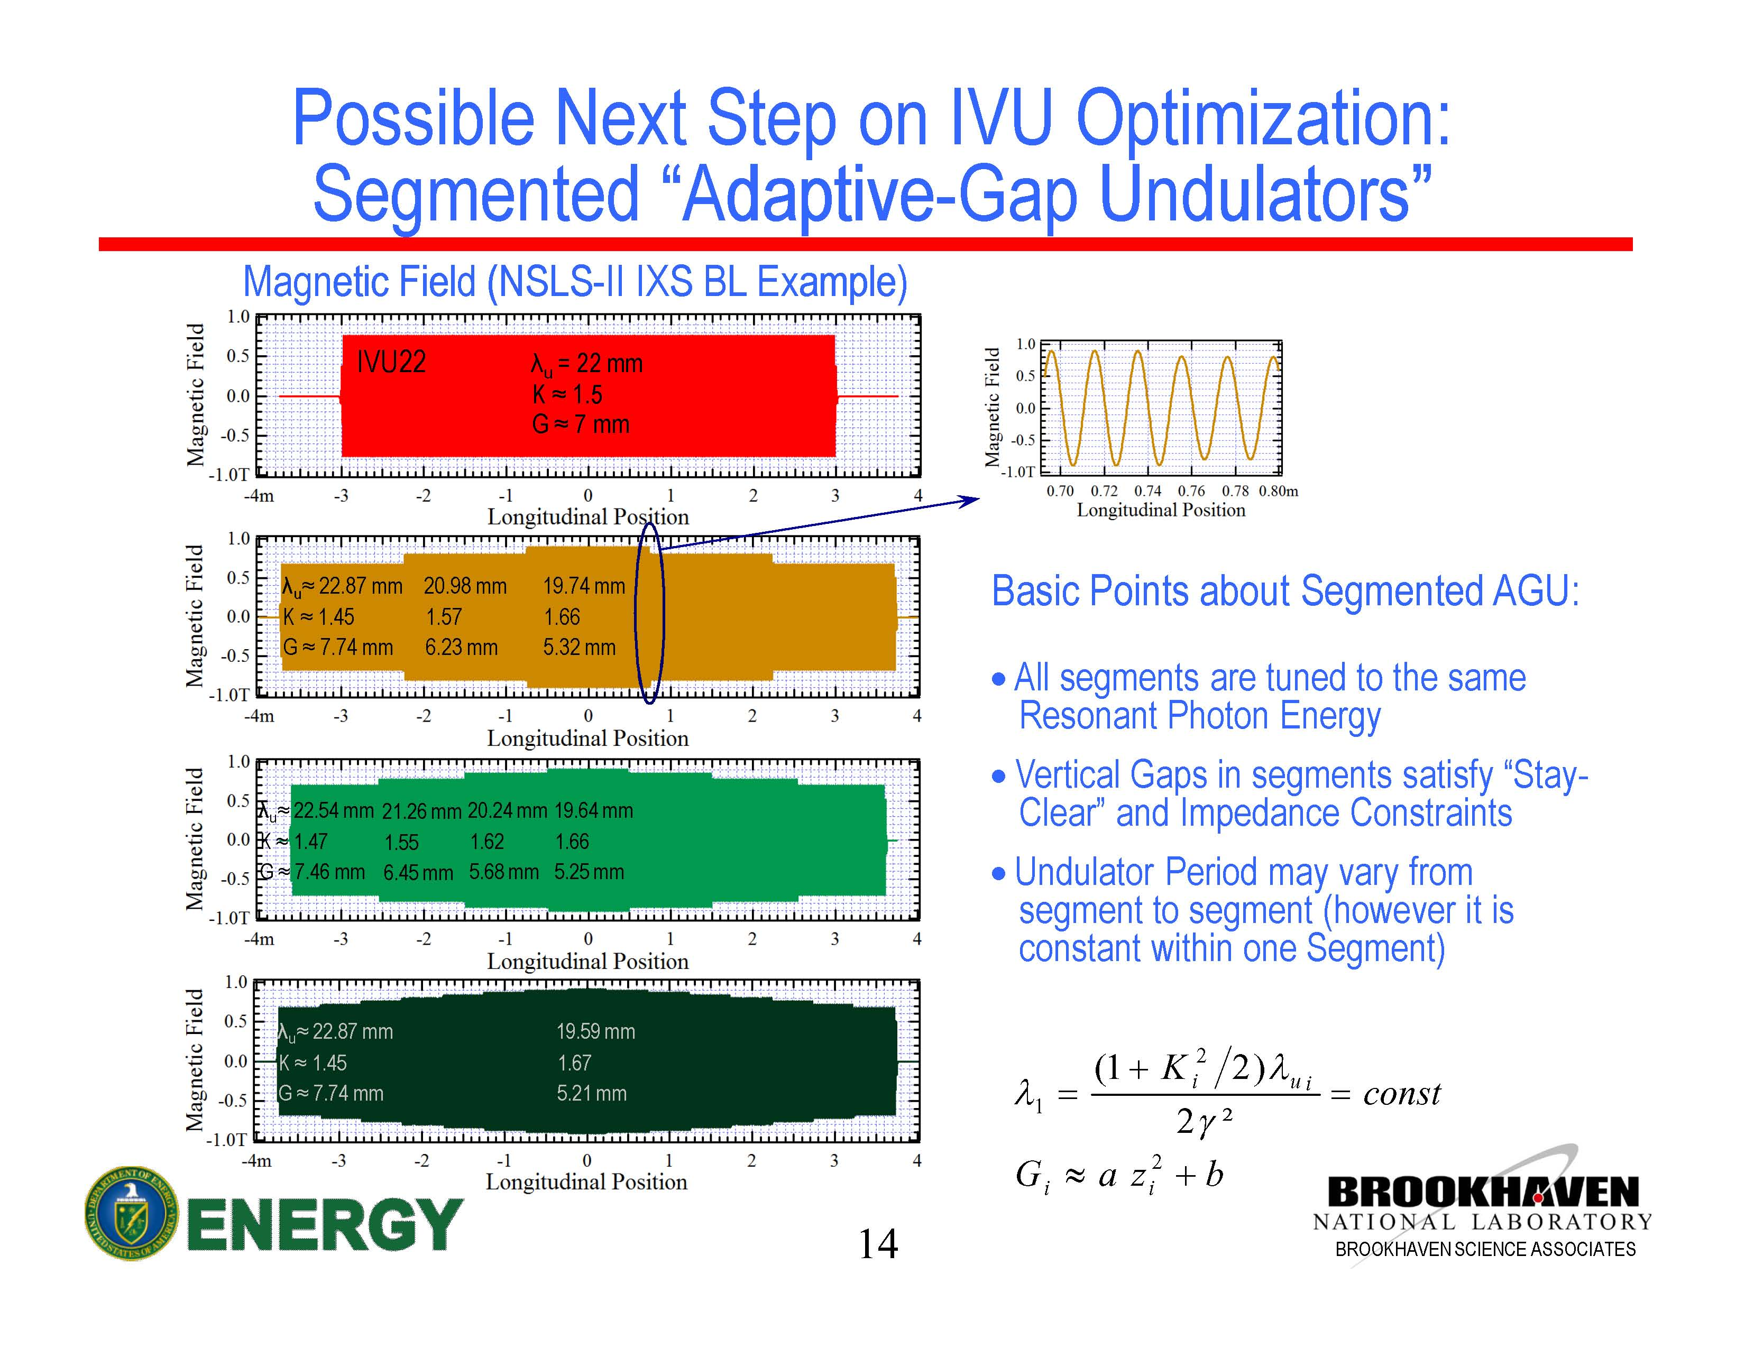

Slide 41
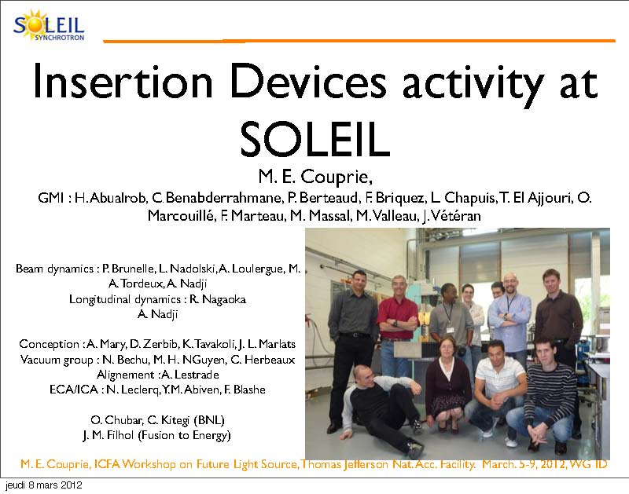

Slide 42
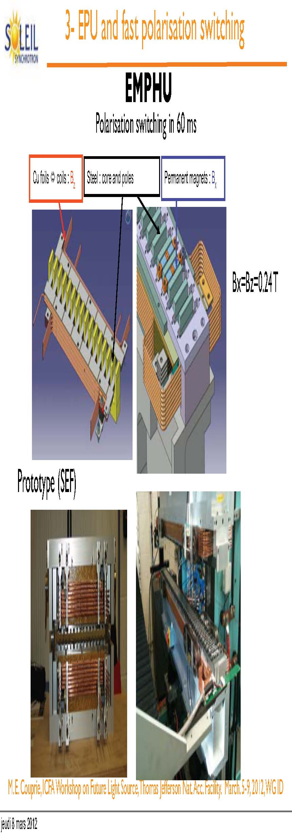

Slide 43
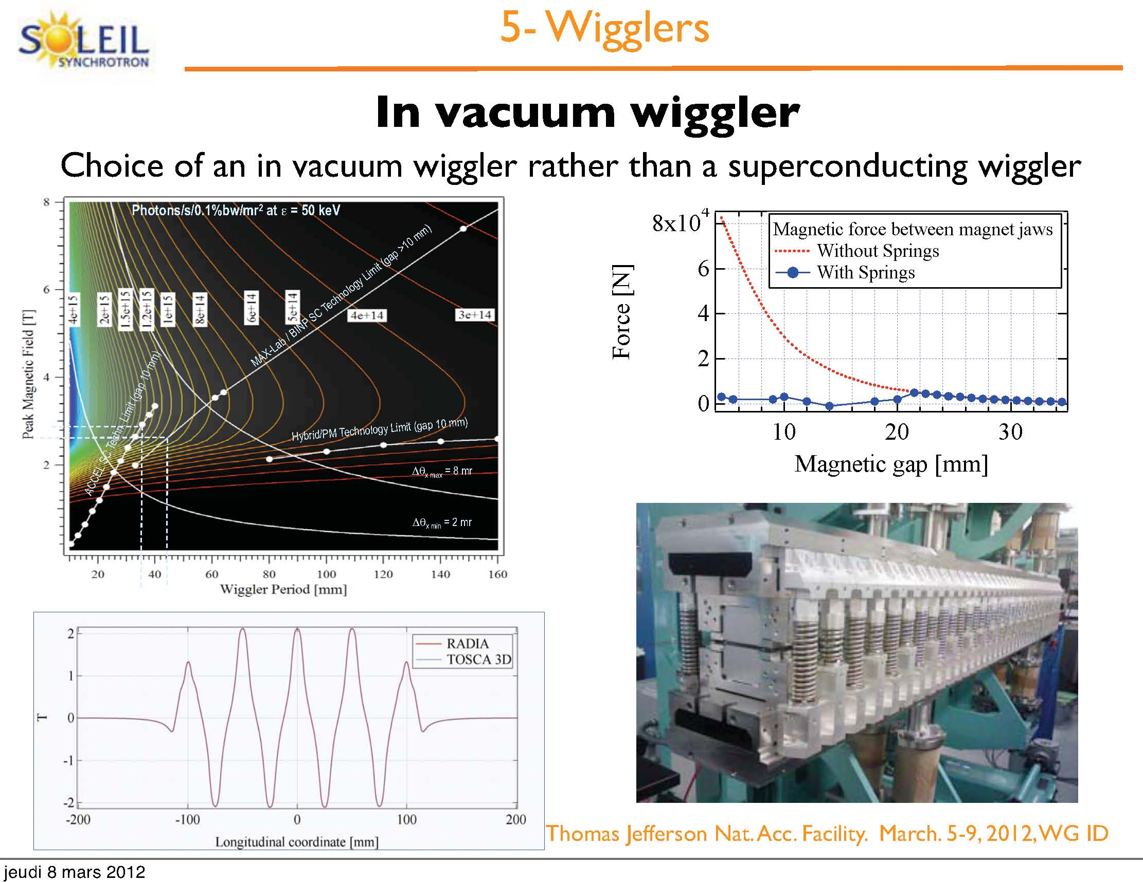

Slide 44
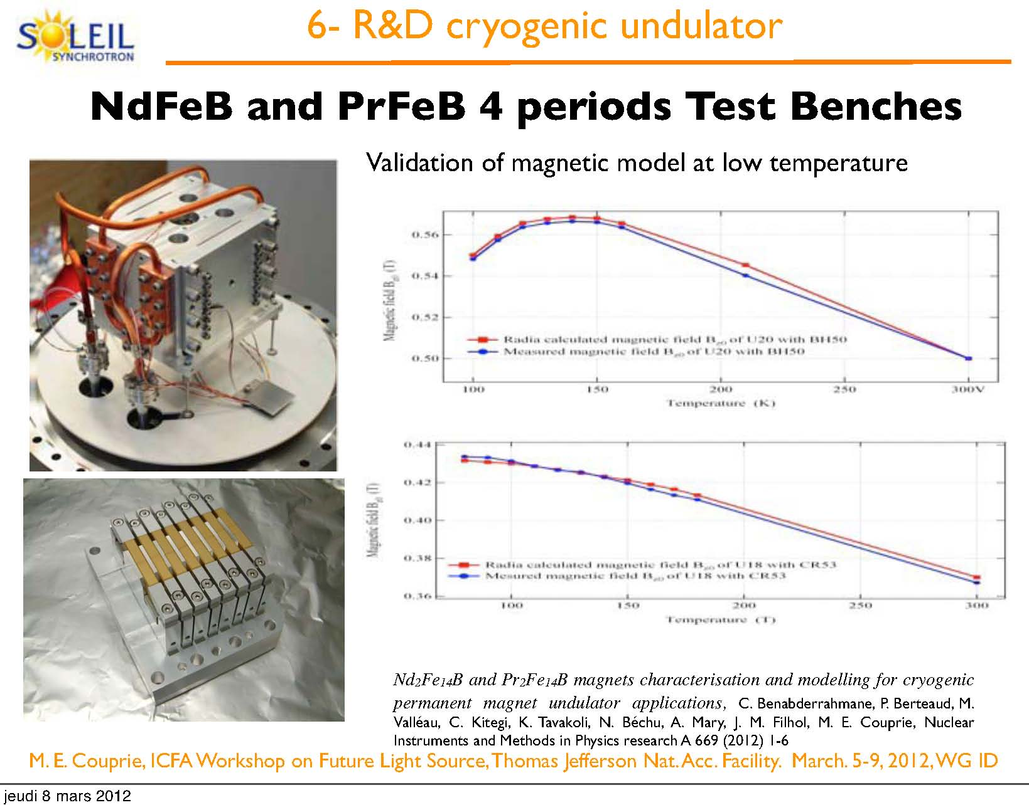

Slide 45
End of Presentation

